Slide 1
Using the FGFOA List Serves

Slide 2
How can the
List Serves benefit me?

Slide 3
Benefits of Using the List Serves
Obtain answers to technical inquiries
Legal, accounting, auditing, financial reporting
Determine best practices
Is what I’m doing okay?
Is there a better way to do it?
Survey others about various topics
Have you heard about . . . ?
Disseminate/receive information to/from others that could be useful
Notes:
There may be a misperception that the List Serve is only for making technical inquiries
In fact, there are several other uses
Many of the questions posted have asked about specific business practices (e.g., billing and collection procedures)
Many have also acted as a survey (e.g., have you heard about a new law, how is it affecting you, etc.)
Also, you can let your peers know about a new law, report, event, etc, and they can do the same for you.

Slide 4
Example List Serve Postings
Accounting and Auditing
How are you accounting for red light ticket revenues collected and the portion paid to the State?
Do you have sample fixed asset disposal procedures and forms you could share?
How do your internal auditors maintain and document their independence?

Slide 5
Example List Serve Postings
Budgeting
Has anyone found a good software for budgeting, financial planning, or cash flow?
If you are a city or county with multiple taxing districts, do you apply the 200.065(5)(a)1 limitation (less than 110%, 2/3 vote) to each individual millage or to the aggregate of operating millages?
What process do you use to develop a capital project idea into an adopted project on the CIP plan? Who is responsible for creating the CIP?

Slide 6
Example List Serve Postings
Debt and Treasury Management
Do you have payment collection procedure you can share?
Are you aware of any law that prohibits including a contingent fee as an "add-on" to the amount placed with a collection agency for a delinquent account?
Does anyone have experience structuring short-term formal debt arrangements?

Slide 7
Example List Serve Postings
Financial Administration
What suggestions do you have for contracting with an ambulance service provider?
Has anyone developed a checklist for contracts & grants (e.g., reporting, CFDA numbers, due dates)?
Do you have a minimum unreserved fund balance policy you could share?

Slide 8
Example List Serve Postings
Personnel and Payroll
Does anyone have any guidelines regarding a paperless payroll (i.e., all direct deposit, no paper checks) that they can share?
What is your cap on accrual of sick and vacation hours for management employees?
For supplemental payrolls for leave hour buy backs, annual allowances, bonuses, etc., do you allow employees to distribute these earnings across various accounts or are they restricted to one account?

Slide 9
How do I get started
using the List Serves?

Slide 10
Notes:
First, on the main FGFOA web page, you will see an icon titled “FGFOA List Serves”
Click on the “List Serves” icon, which will take you to the FGFOA List Serves web page (see next slide)

Slide 11
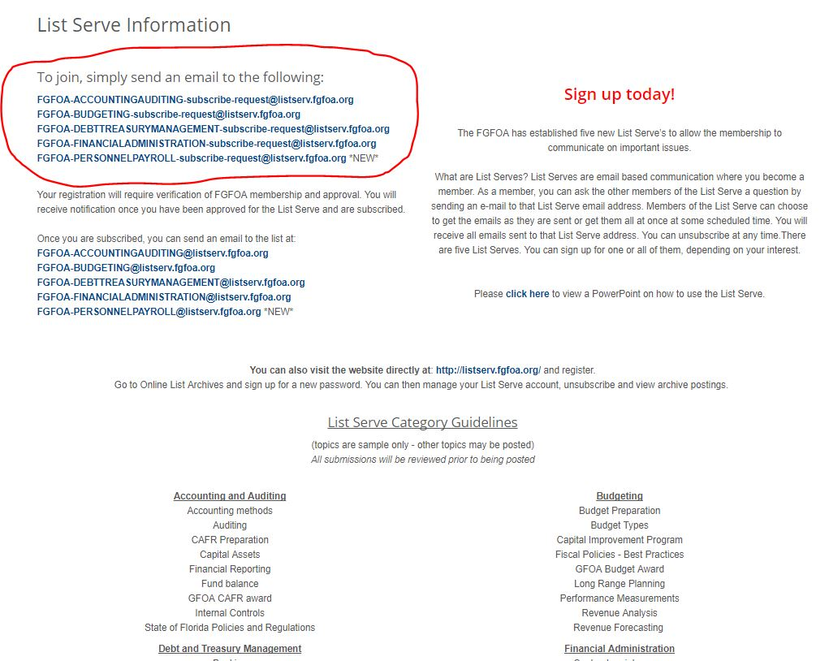
Notes:
This web page tells you about the List Serve categories
Sample topics are provided for most categories
If you scroll down, you’ll eventually see what’s on the next slide

Slide 12
Notes:
This is an example of an email sent to join the Financial Administration List Serve
After you send the email, you’ll get a response email (see next slide)

Slide 13
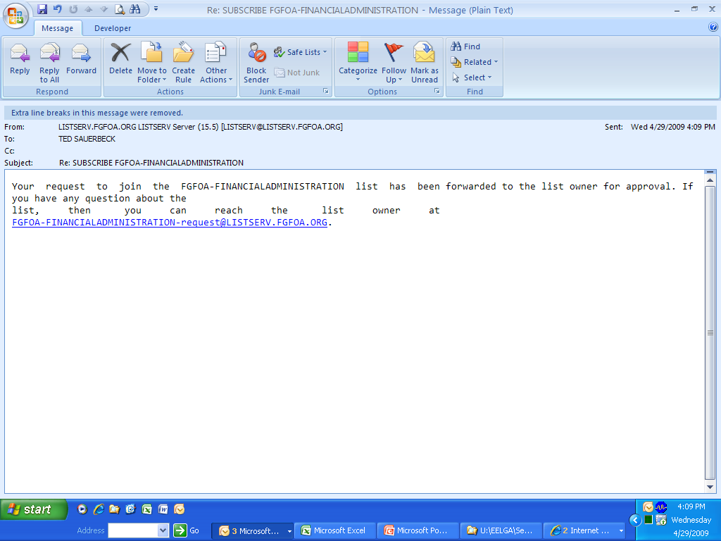
Notes:
This email will let you know that your request is being considered
After verification that you are an FGFOA member, you’ll receive an email notifying you that you have been approved for the List Serve and are subscribed
You should receive this notification email in less than an hour (see next slide)

Slide 14
“To reduce the chance of servers blocking incoming listserv emails, we recommend that user’s have their email administrator white list, at minimum, the following IP addresses:
209.119.0.145 [lychee.ease.lsoft.com]
209.119.0.170 [loquat.ease.lsoft.com]
209.119.0.189 [louvi.ease.lsoft.com]
67.94.7.99 [listserv.fgfoa.org]
All of our mail is sent from various servers in the following address blocks:
209.119.0.0/24
209.119.1.0/24
69.94.7.0/24
(We own all three blocks, and have outbound servers in each.)”

Slide 15
Now that I’m
Registered, how do I
post a message to
a List Serve?

Slide 16
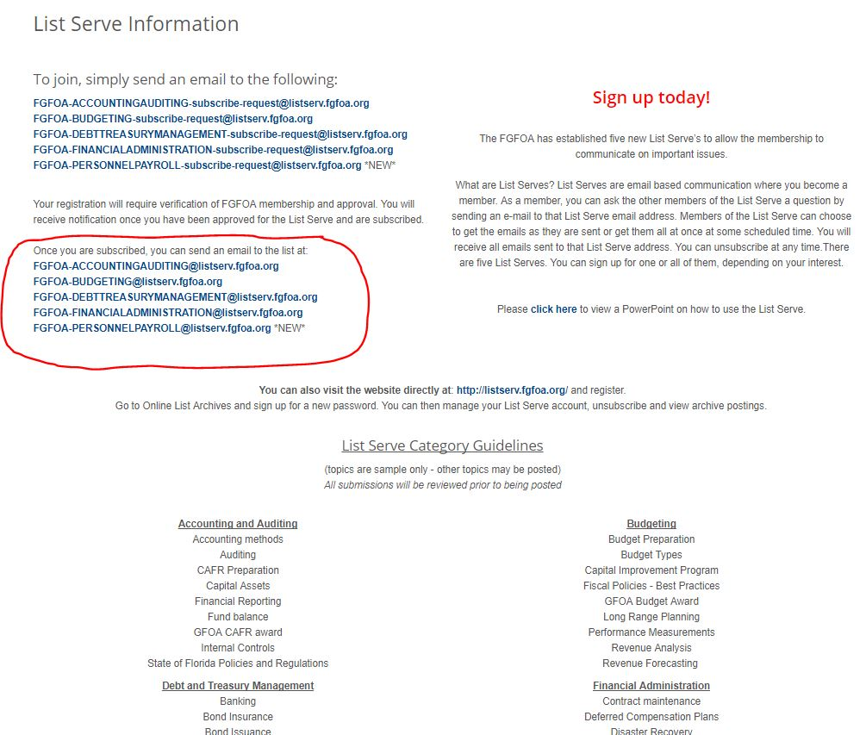
Notes:
There are two ways to post a question or message to the List Serve:
You can go to the List Serve web page (see slide) and click on the link for the category you are interested in, which brings up an email
or
You can respond to emailed postings you receive

Slide 17
Notes:
This is an example of an email with a technical inquiry (answer would be GASB Statement No. 51)
Since it relates to accounting/financial reporting, it would be posted to the Accounting and Auditing List Serve
It’s important to put something in the subject category
Remember that there are five (5) List Serve categories
Guidelines as to what topics relate to each category are on the main List Serve web page

Slide 18
How will I know when
someone has responded
to my question?

Slide 19
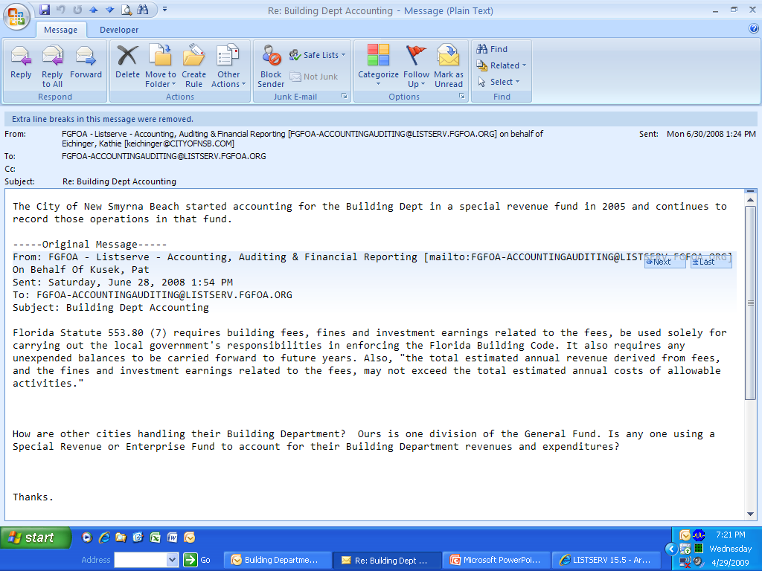
Notes:
If you have elected to receive emails of all postings for the List Serves you’ve joined:
You will receive an email showing each posting to those List Serves (see above example)
Otherwise, you would have to check the List Serve archives

Slide 20
How do I search
the archives for postings
about a particular topic?

Slide 21
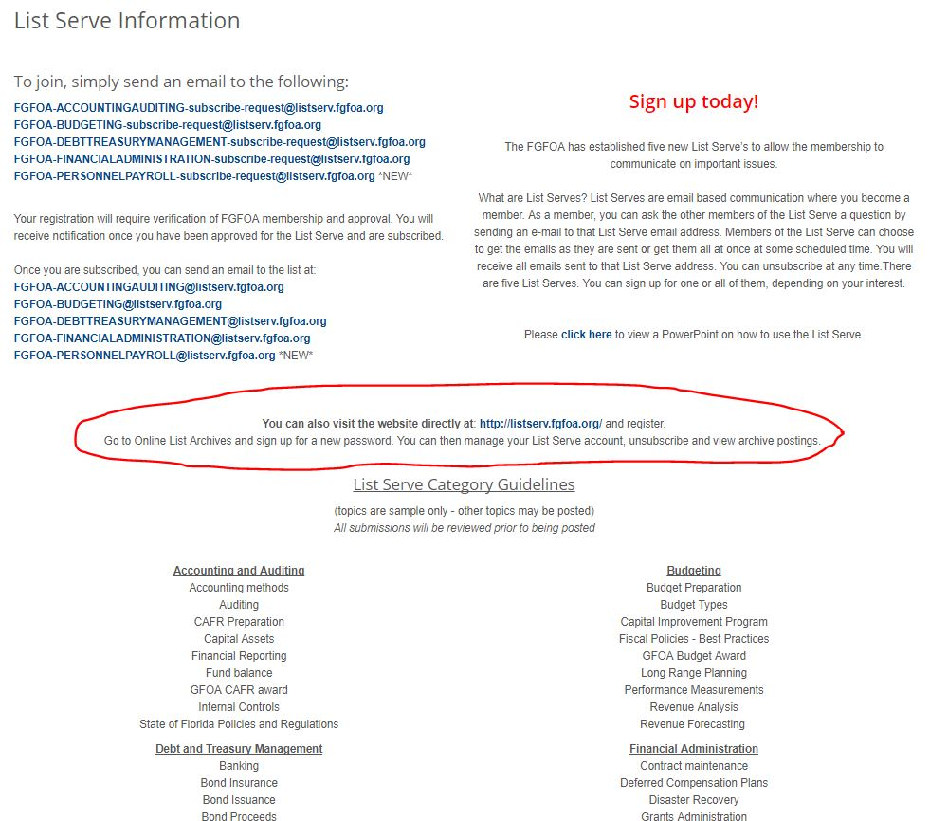
Notes:
To search the archives you need to click on the link http://listserve.fgfoa.org from the main List Serve web page (shown above)
This will take you to the LISTSERVE Archives web page (see next slide)

Slide 22
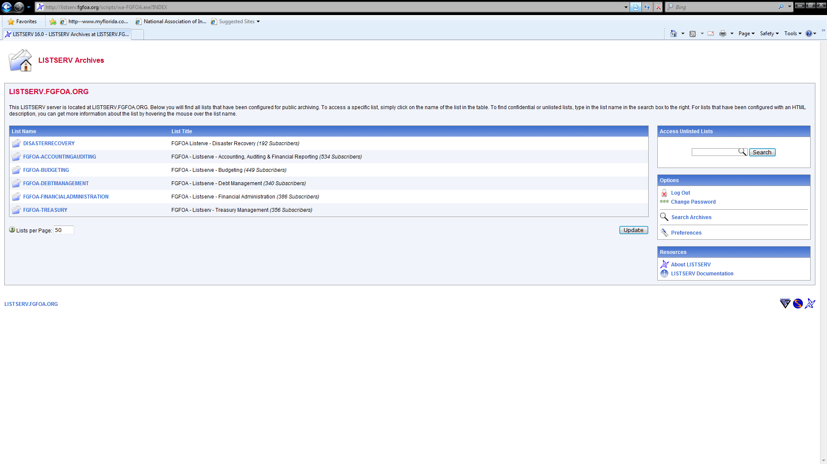
Notes:
If you’ve used the archives before then you already have a password and would click on “Log In”
The first time you go to use the archives you’ll need to get a password
To do this, click on “Get Password,” which will take you to the “Register LISTSERVE Password” web page (see next slide)

Slide 23
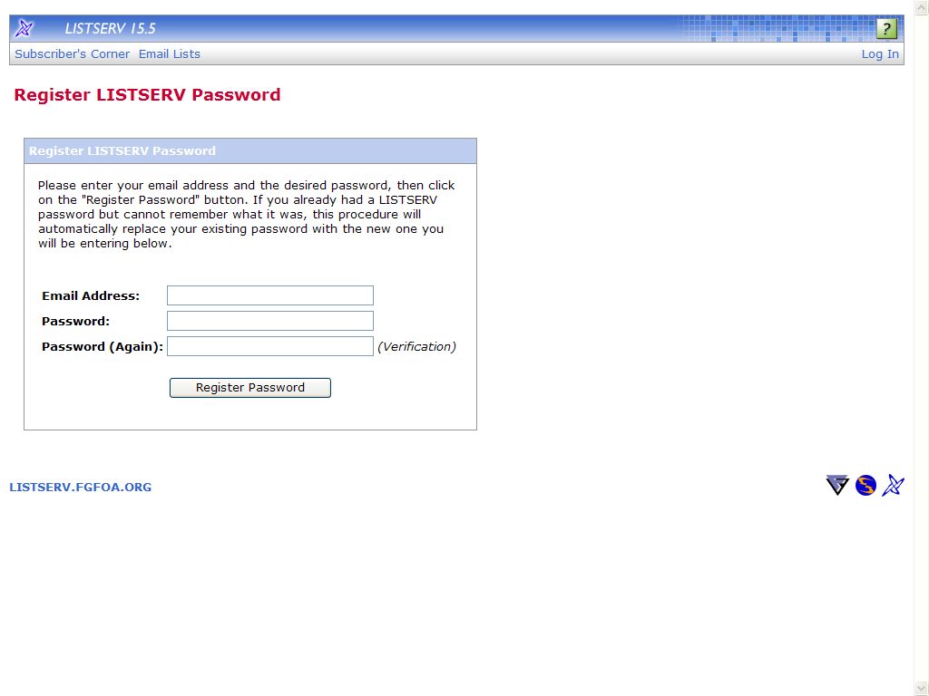
Notes:
On this web page, fill in the boxes and click “Register Password”
You’ll then receive a notification that your request for a password has been granted, and you’ll end up at the “LISTSERVE Archives” web page again (see next slide)

Slide 24
Notes:
From the LISTSERVE Archives web page, click on “Search Archives,” which will take you to the “Archive Search” web page (see next slide)

Slide 25
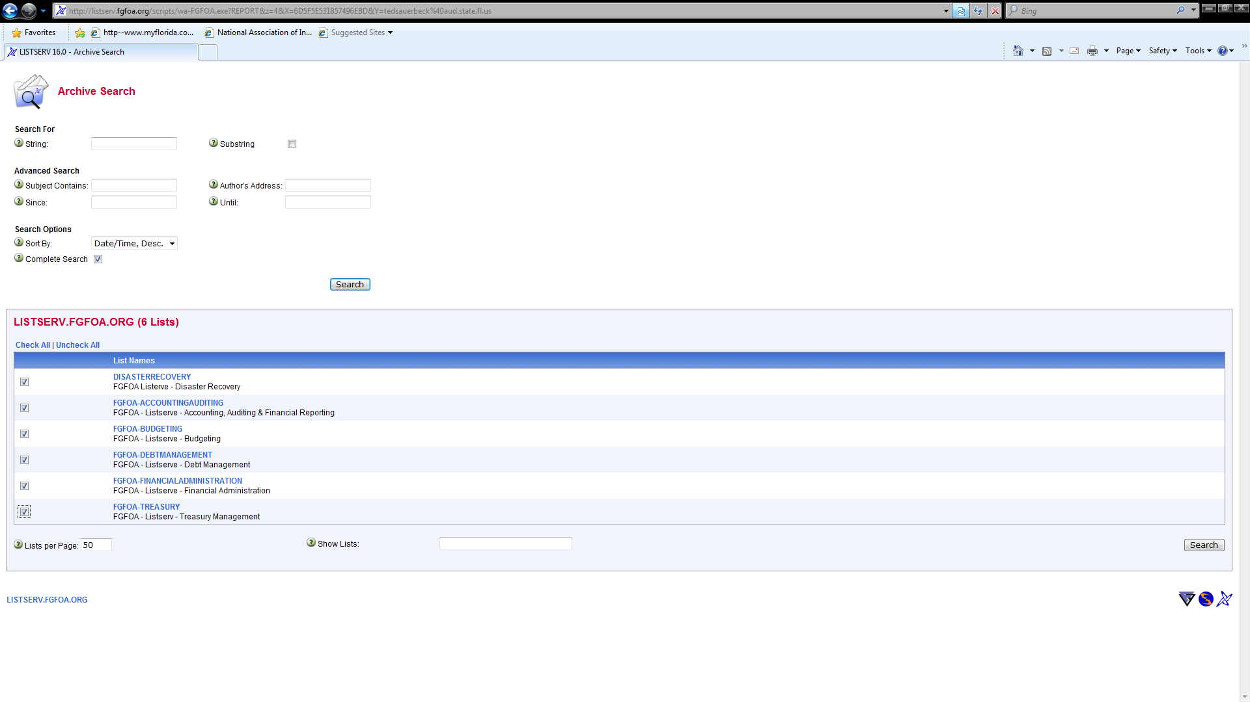
Notes:
On this web page, type in a keyword or words for the topic you are interested in in the search string box, and then select all List Serve categories you are interested in. Note: It is recommended that you select all categories because many times messages are not posted to the proper List Serve category
Then click on “Search,” which will bring up a list of all posted messages matching the search string in the selected categories (see next slide)

Slide 26
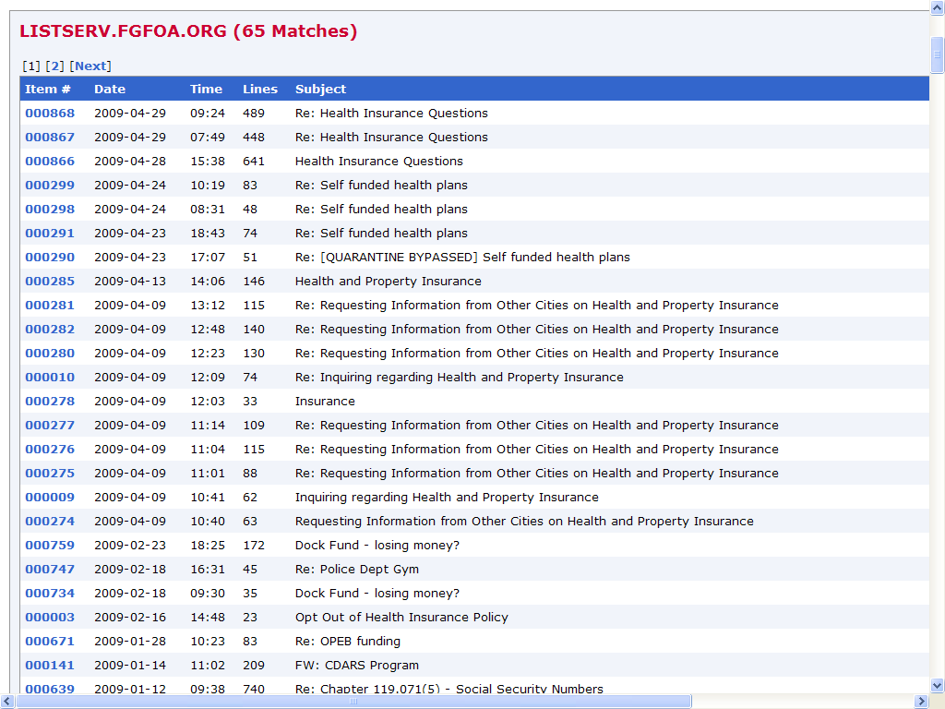
Notes:
The above is an example of a search for all posts relating to “insurance”
From here, click on the messages you’re interested in
The subject field gives you an idea of what the message is about
For example, if you clicked on message 4919, it would bring up a screen as shown on the next slide

Slide 27
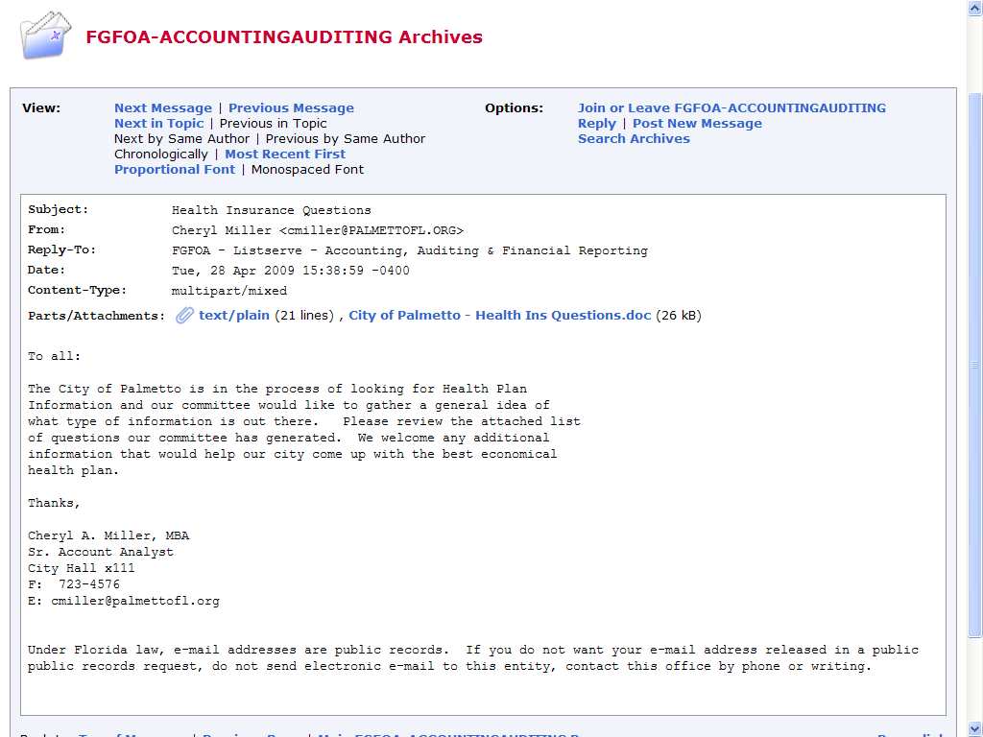
Notes:
This happens to be a question about a high deductible health plan

Slide 28
How do I search
the archives using
Subscriber’s Corner?
Notes:
Another way to search the archives is to use Subscriber’s Corner
To do this, from the main List Serve web page click on the link “http://listserve.fgfoa.org,” which will take you to the “LISTSERVE Archives” web page (see next slide)

Slide 29
Notes:
From this web page, click on “Subscriber’s Corner” (located in the upper left corner), which will take you to the “Subscriber’s Corner” web page (see next slide)

Slide 30
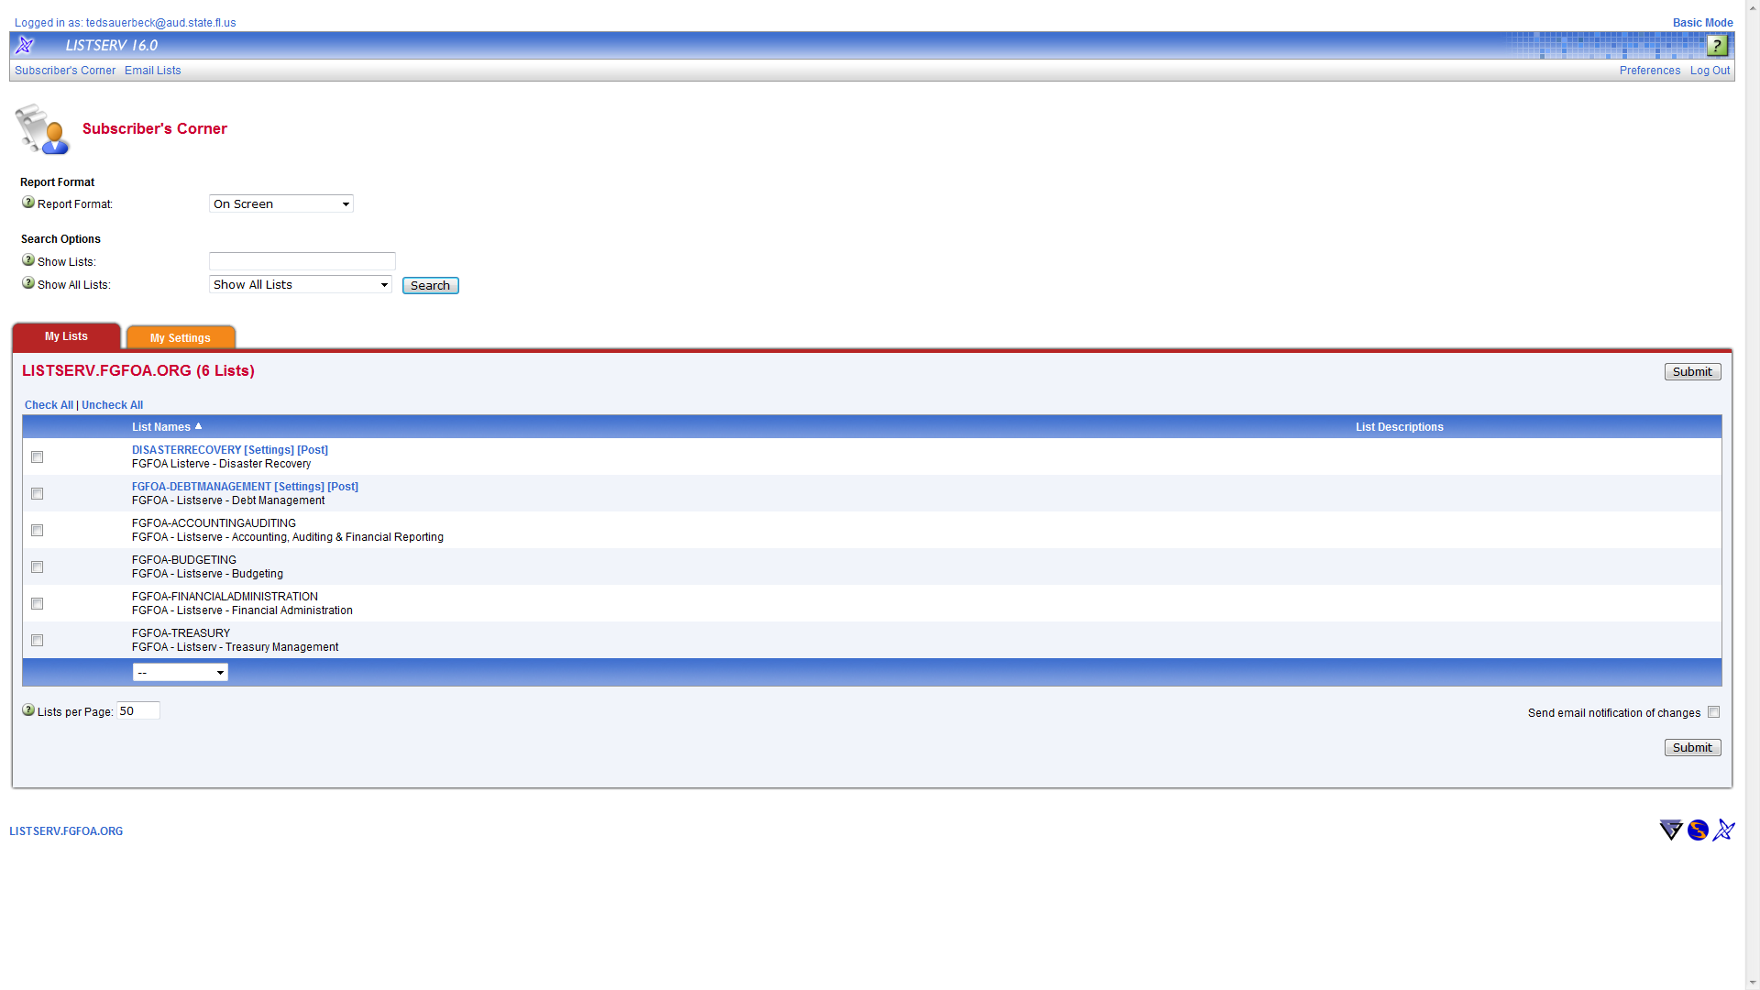
Notes:
On this web page, click on the List Serve category you are interested in
This will bring up a web page for that List Serve category (see next slide)

Slide 31
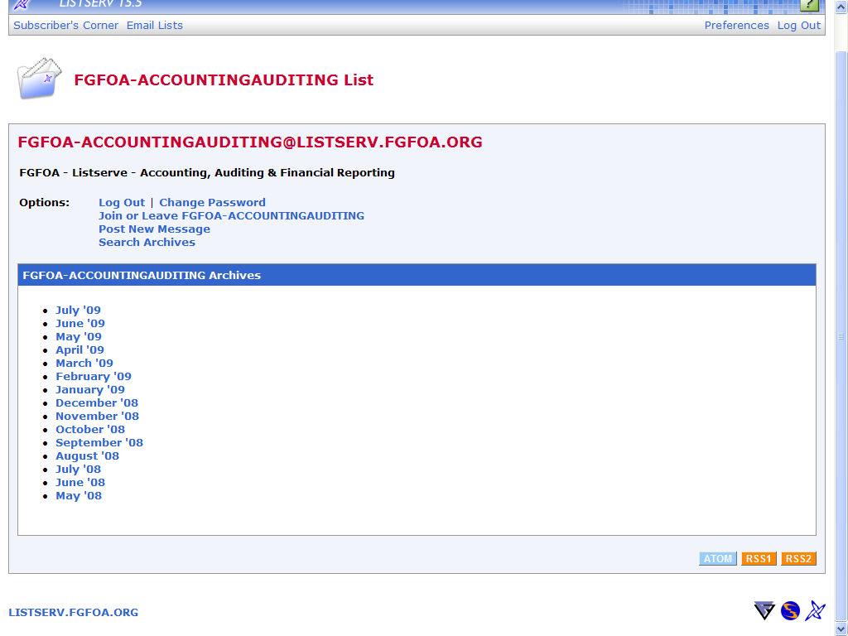
Notes:
This is an example of what you would see for the Accounting and Auditing List Serve category
Just click on a month and it will bring up a web page showing all the messages posted during that month for the selected category (see next slide)

Slide 32
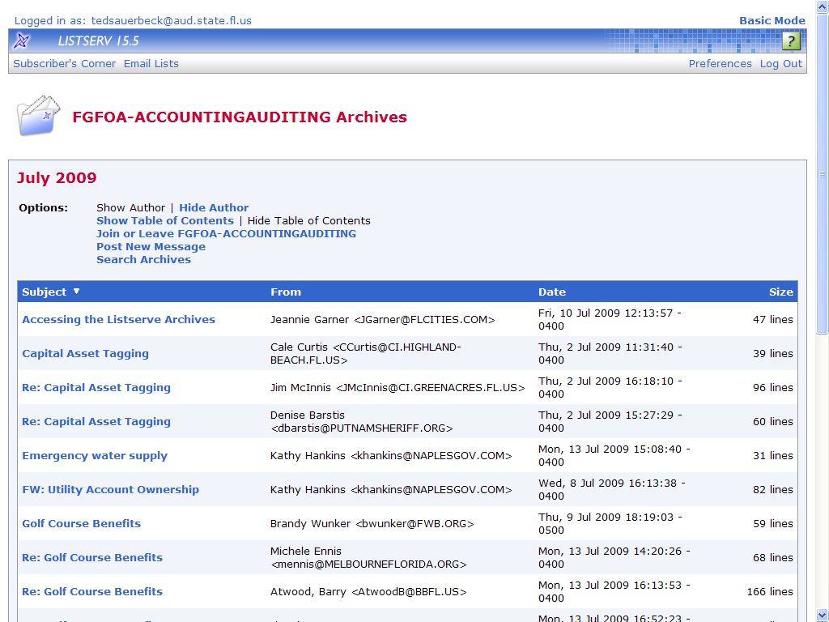
Notes:
From here, browse through the messages
The subject field gives you an idea of what the message is about
Just click on those messages you’re interested in to view the entire posted message

Slide 33
What are the dos
and don’ts of using
the List Serves?

Slide 34
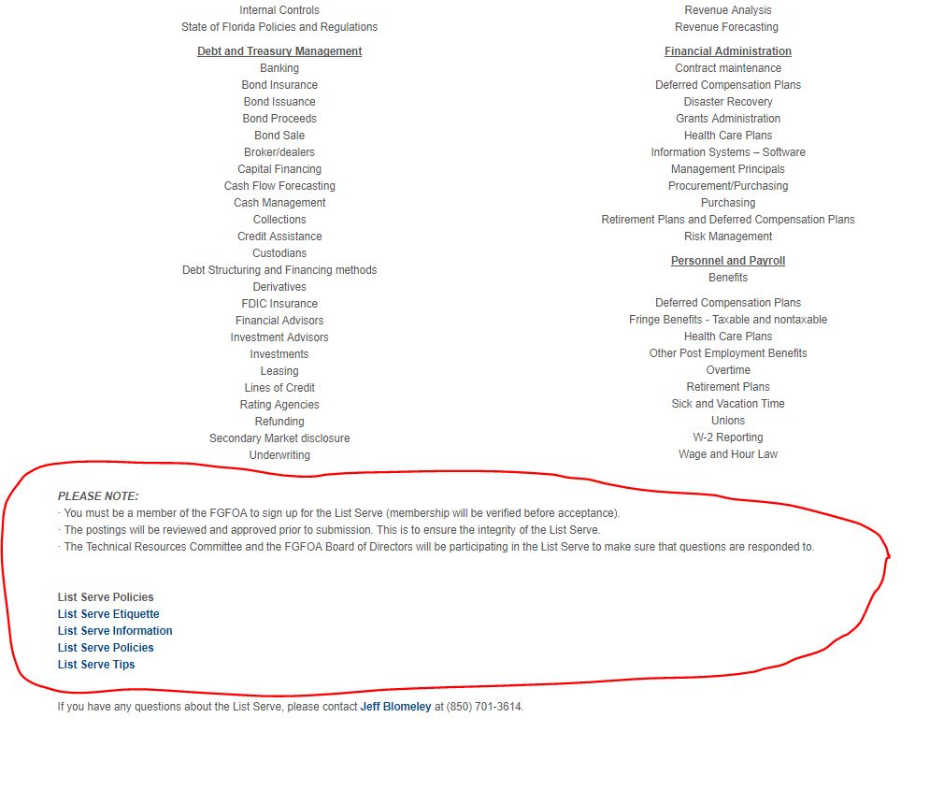
Notes:
Back on the main List Serve page there are three links that provide information about using the List Serves, including what to do and what not to do
They are:
List Serve Etiquette
List Serve Policies
List Serve Tips
Please read the information on these web pages the first time you begin register to use the List Serves

Slide 35
Examples of Improper Categories
Message | Category Used | Correct Category
Has anyone used zero based budgeting? How would you compare to line item budgeting? | Accounting & Auditing | Budgeting
Does anyone have procedures regarding calculation of taxable fringe benefits they could share? | Accounting & Auditing | Financial Administration
How do you determine what rates to charge for rental of your facilities? | Budgeting | Financial Administration
Notes:
The most prevalent problem is the use of the wrong List Serve category
It is important to use correct category to facilitate use of the archive search function and to ensure that those signed up only receive messages they interested in
The category most commonly used by mistake is Accounting and Auditing. Most of the messages in that List Serve should be in a different List Serve
The above are examples of incorrect categorization of postings

Slide 36
List Serve Usage - Things to Remember
Use correct List Serve category
Email Merrily Bennett at mbennett@flcities.com about email changes
Don’t respond to questions that have already been answered correctly
Check sample documents on FGFOA web site before using List Serve to ask for a sample policy, contract, RFP, etc.
Don’t send a thank you to responder

