Slide 1
Basic Government Resource Manual
Presented by: the FGFOA Technical Resources Committee

Slide 2
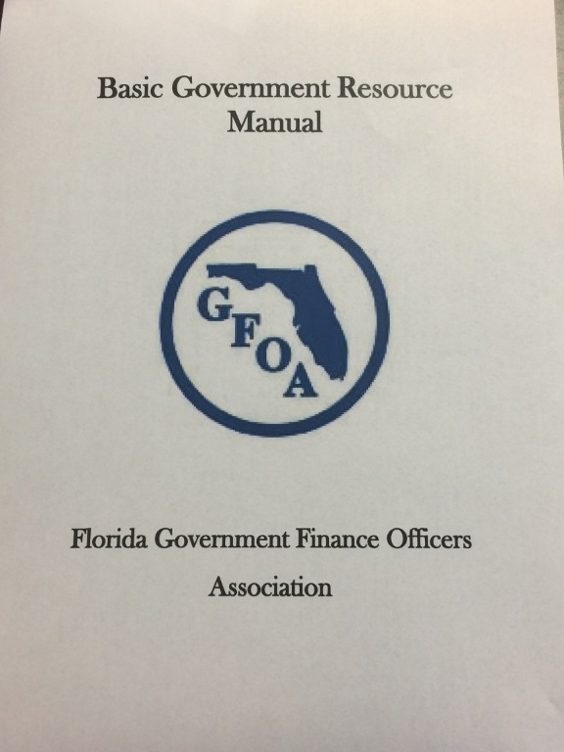
Overview
Where can I find it? http://www.fgfoa.org/resources/on-line-manual
Who is it useful for?
Who updated it?
Technical Resources Committee
Monitor Listserves
Answer GASB exposure drafts for the FGFOA
What resources were used to build it?
Why the update?
What’s in it?
http://www.fgfoa.org/docs/default-source/Resources/government_resource_manual_2017.pdf?sfvrsn=0

Slide 3
Section 1 - Accounting
The official source of generally accepted accounting principles (GAAP) for local governments is the Governmental Accounting Standards Board (GASB)
218.33 F.S., requires local governments to follow uniform accounting practices and procedures and a uniform chart of accounts as established by the Florida Department of Financial Services (DFS)

Slide 4
Section 2 - Annual Financial Audit
Properly performed audits play a vital role in the public sector by helping to preserve the integrity of public functions and by maintaining citizens’ confidence in their elected leaders
Annual audited financial report could also be required to include a “single audit”
Information must also be submitted to the Auditor General.
Auditor Selection Process

Slide 5
Section 3 - Annual Financial Reporting
Local governments are accountable for how they spend public funds
Two types of local government annual financial reporting:
State Annual Financial Report (AFR)
Comprehensive Annual Financial Report (CAFR)

Slide 6
Question
What is the official source on generally accepted accounting principles for local governments?
Auditor General
DFS
GASB
FL Statutes

Slide 7
Section 4 - Budgeting
What is a Budget?
Budget Development Cycle
Florida Statutory Requirements
Annual Budget Document and GFOA Award Program

Slide 8
Section 5 - Capital Assets
Valuation Rules, what is cost?
Capitalization Threshold and Accountability
Capital Asset Maintenance and Replacement Policy
Depreciation
Capital Assets Reporting—GASB 34

Slide 9
Section 6 - Capital Planning
Capital Planning Life Cycle
Capital Planning Process
What is included in CIP (Capital Improvement Plan)?
Funding Capital Projects

Slide 10
Section 7 - Cash Management and Investing
Investing public funds is a core responsibility of local government finance professionals and can be one of the most complicated responsibilities.
The main objectives of effective cash management and investing public funds are (in this specific order);
Safety
Liquidity
Yield

Slide 11
Question
What is (are) the main objective(s) of effective cash management and investing public funds?
Safety, Value
Liquidity
Safety, Liquidity & Yield

Slide 12
Section 8 - Cash Receipts/Accounts Receivable
It is necessary to establish an adequate system of controls to assure that all amounts owed to the government are collected, documented, recorded, and deposited to the bank accounts of the government entity, and to detect and deter error and fraud.
Small Government Considerations
Some Common Pitfalls Are Highlighted

Slide 13
Section 9 - Dates to Remember
Finance Officers of counties, including constitutional officers, municipalities, and special districts have statutory and program requirements to complete a wide variety of daily, monthly, quarterly, and annual procedures and reports
There are professional organizations to provide guidance along with the Florida State Statutes and Florida Administrative Codes. A list of references and contact information is included.

Slide 14
Section 10 - Debt Management Policy
Comprehensive Strategic Financial Plan
Compliance with Florida Statutes
Types of Debt
Selection of Bond Professionals
Reporting Requirements

Slide 15
Question
The Uniform Accounting System Manual was promulgated by the Department of Financial Services.
True
False

Slide 16
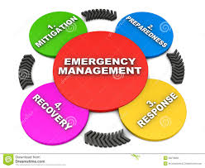
Section 11 - Emergency Management
Responsibilities of the Emergency Management Department
Maintaining various plans
Emergency Operations Center
Oversee grants from Department of Homeland Security
Training and preparedness

Slide 17
Section 12 - Human Resources
Oversees most all activities associated with employees:
Recruitment
Training
Job Descriptions
Employee Manual
Employee Files
Work with legal counsel to enforce federal, state and local regulations

Slide 18
Section 13 - Intergovernmental Relationships
Three Levels of intergovernmental relationships
Primary task of local governments is to provide appropriate level of service to citizens in their respective jurisdictions
Citizens dwelling in any given geographical location will likely be subject to more than one local government empowered to enact legislation, impose taxes and charge fees.
Interlocal agreements authorized by The Florida Interlocal Cooperation Act of 1969 (Section 163.01, F.S .) can give associating governments the authority to provide services

Slide 19
Section 14 - Payroll
Payroll processing is an important function in any governmental organization.
Payroll Process
Vacation, Sick, compensatory and other leave balances should be reconciled periodically
Helpful Hints

Slide 20
Section 15 - Public Records/Sunshine Law (Open Government)
Open government laws include :
The Public Records Law (ch. 119, F.S.)
The “Sunshine Law” (See s. 286.011, F.S.)
Attorney General is responsible through the Florida Department of Legal Affairs (DLA).
Issue Resolution

Slide 21
Section 16 - Purchasing
A government should have a purchasing policy
Purchasing Cards
Local Government Prompt Payment Act
Internal controls

Slide 22
Question
In case of a disaster, the County Emergency Management Department takes over the operations of the entire county.
True
False

Slide 23
Section 17 - Reporting Requirements
The Joint Legislative Auditing Committee (JLAC) has prepared a comprehensive listing of reporting requirements for local governments including special districts
The Office of Economic & Demographic Research (EDR) has prepared a calendar related to local government financial reporting

Slide 24
Section 18 - Retirement Plans
Retirement plans fall into three general categories
Deferred Retirement Option Plans (DROP)
Essential Elements of a Retirement Plan
Financial Accounting for Pension Plans

Slide 25
Section 19 - Revenues
Authorized By State Constitution and State Law
Home Rule Authority Revenues
Revenues Authorized By the Legislature
Financial Reporting Issues For Revenues

Slide 26
QUESTION
In what fund types of the Financial Statements are Ad Valorem and State Shared Revenues Usually Recorded ?
Governmental
Business Type
Fiduciary
None

Slide 27
Section 20 - Risk Management
Implementing Risk Management Program
Identifying Types of Risks
Transfer or Retain Risk? – Risk Assessments
Traditional Insurance Coverages vs. Self Insurance
Public Entity Risk Pools
Risk Avoidance, Safety Programs

Slide 28
Section 21 - Strategic Planning
Help organizations assess the current environment
Anticipate and respond to changes in the environment
Envision the future
Steps to Establishing a Strategic Plan

Slide 29
Section 22 - Unclaimed Property
Local governments must comply with the unclaimed property provisions
Monetary penalties can be imposed for noncompliance
Recordkeeping
Abandoned or Lost Tangible Personal Property
Helpful Suggestion - http://www.fltreasurehunt.org/index.jsp

Slide 30
Question
Unclaimed property laws apply to?
Wages
Vendor Payments
Both

Slide 31
Conclusion
Basic Government Resource Manual http://www.fgfoa.org/resources/on-line-manual
Questions, ideas, potential changes e-mail the Technical Resources Committee Chair, Melissa Burns at mburns@cityofsab.org

