Slide 1

Internal Control Over Governmental Financial Reporting
Presented by
Israel Gomez, CPA, Partner
Marc Grace, CPA, Manager

Slide 2

Overview for today’s webinar
What are some of the risks of material misstatement in governmental financial reporting?
Committee of Sponsoring Organizations of the Treadway Commission “COSO” & the Standards for Internal Control in the Federal Government “the Green Book”.
Control activities that assist with your financial reporting.

Slide 3
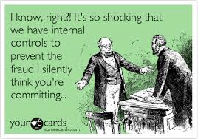
Internal Controls
What is internal control?
Limitations of internal control

Slide 4
Why are internal controls important to governmental entities?
More people to answer to than your average commercial entity
Involuntary nature of revenues
Factors not controlled by the government
Who is responsible when something goes wrong?

Slide 5
Governmental Risk Factors
Structure and Governance
  Complexity of the organization
  Effectiveness of oversight body and related committees
  Changes in management
  Outsourcing activities

Slide 6
Governmental Risk Factors
Industry, Regulatory, and Other External Factors
  Taxpayer sensitivity
  New accounting pronouncements
  Federal, state and local regulations and compliance requirements
  General economic conditions
  Litigation and self-insured activities

Slide 7
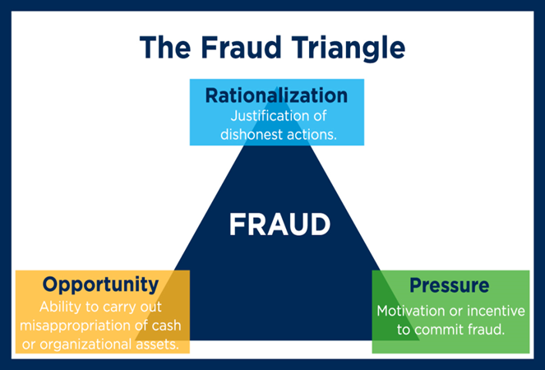
Fraud Risks
Fraudulent Financial Reporting
Misappropriation of Assets
Noncompliance

Slide 8
COSO:
Internal Control – Integrated Framework
COSO (Committee of Sponsoring Organization of the Treadway Commission)
Originally issued in 1992
Why the update in 2013?
The Green Book - 2014
More information available at:
  www.coso.org
  www.gao.gov/greenbook/overview

Slide 9
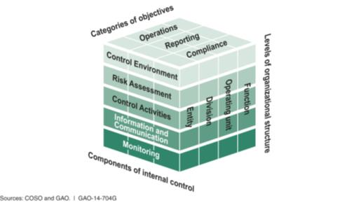
Five Components of COSO
Control Environment
Risk Assessment
Control Activities
Information and Communication
Monitoring

Slide 10
Control Environment - Principles
1. The oversight body and management should demonstrate a commitment to integrity and ethical values.
2. The oversight body should oversee the entity’s internal control system.
3. Management should establish an organizational structure, assign responsibility, and delegate authority to achieve the entity’s objectives.
4. Management should demonstrate a commitment to recruit, develop, and retain competent individuals.
5. Management should evaluate performance and hold individuals accountable for their internal control responsibilities.

Slide 11
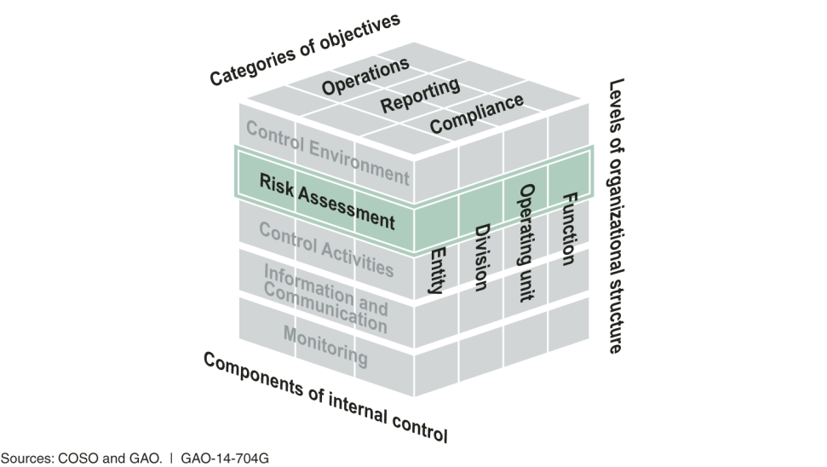
Risk Assessment - Principles
6. Management should define objectives clearly to enable the identification of risks and define risk tolerances.
7. Management should identify, analyze, and respond to risks related to achieving the defined objectives.
8. Management should consider the potential for fraud when identifying, analyzing, and responding to risks.
9. Management should identify, analyze, and respond to significant changes that could impact the internal control system.

Slide 12
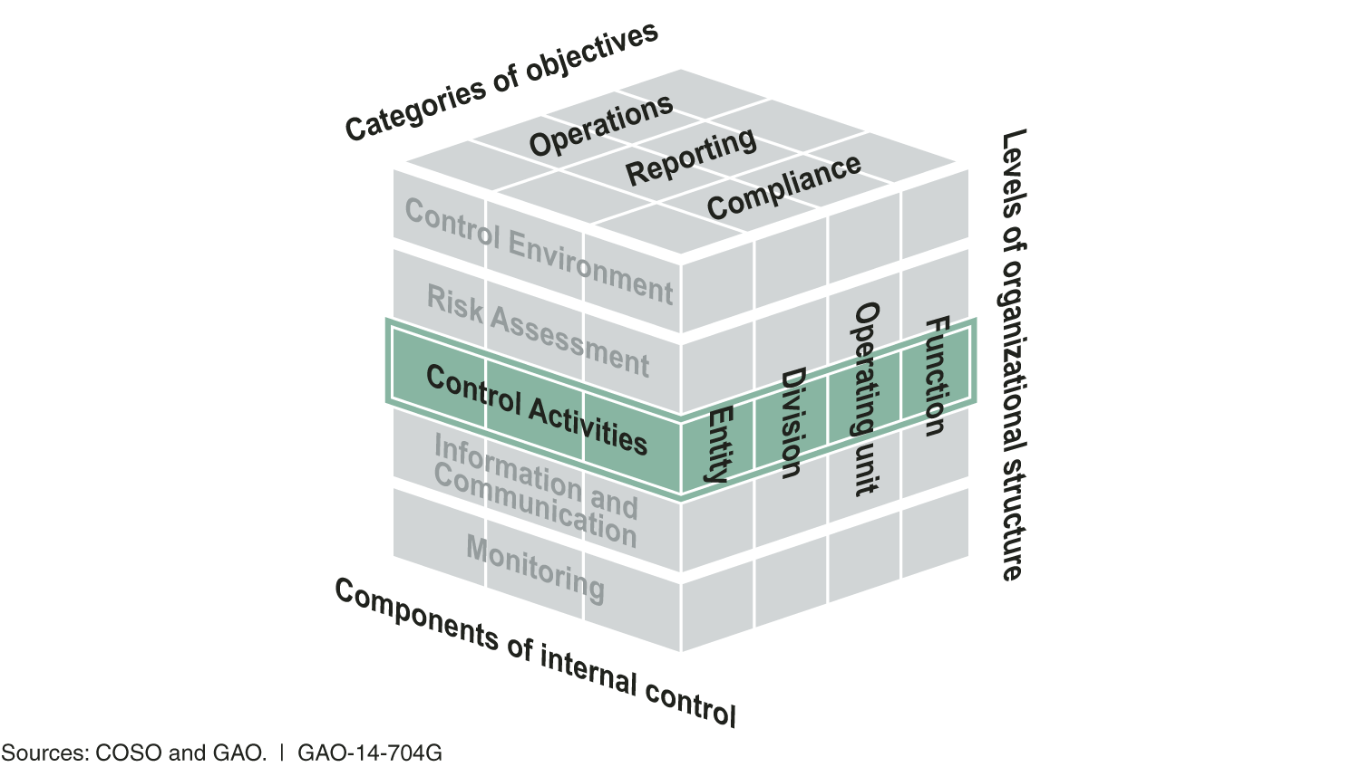
Control Activities - Principles
10. Management should design control activities to achieve objectives and respond to risks.
11. Management should design the entity’s information system and related control activities to achieve objectives and respond to risks.
12. Management should implement control activities through policies.

Slide 13
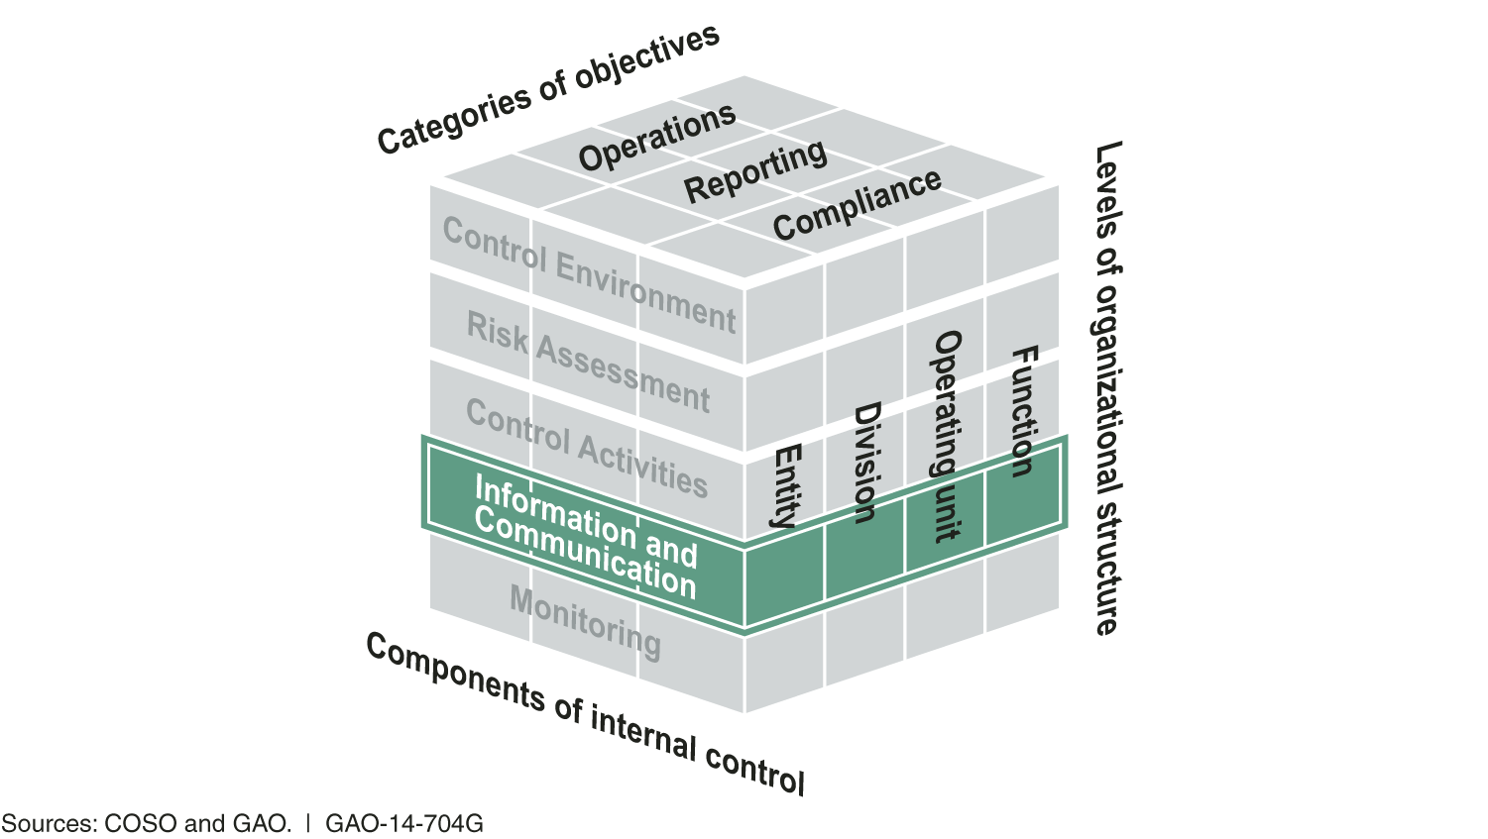
Information and Communication - Principles
13. Management should use quality information to achieve the entity’s objectives.
14. Management should internally communicate the necessary quality information to achieve the entity’s objectives.
15. Management should externally communicate the necessary quality information to achieve the entity’s objectives.

Slide 14
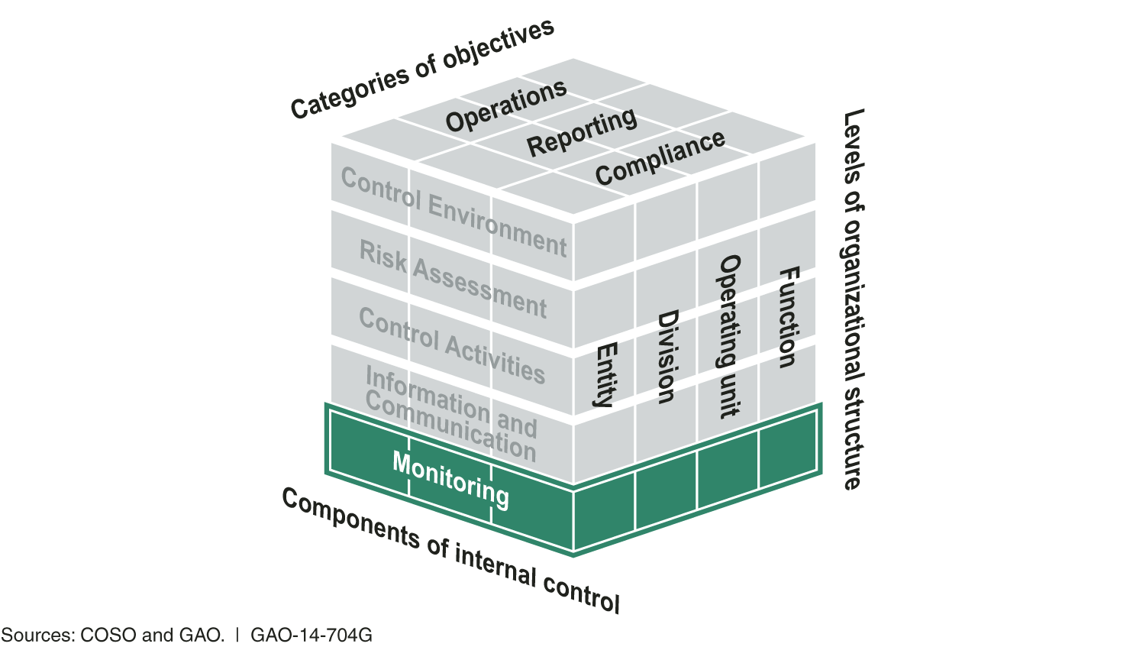
Monitoring - Principles
16. Management should establish and operate monitoring activities to monitor the internal control system and evaluate the results.
17. Management should remediate identified internal control deficiencies on a timely basis.

Slide 15
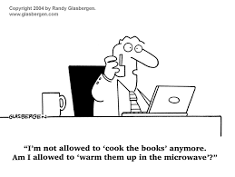
Control Activities - Cash
Processing cash receipts
  Timely deposits
  Reconciliations
  Separate bank account – contractually
Processing cash disbursements
  System rejections
  Duplicate vendors
  Supporting documentation
  Reconciliations
  Pre-numbered
  Check signers

Slide 16
Control Activities - Revenues & Receivables
Rates and fees
  Schedule of fees
Reconciliations – proper coding
Pre-numbered documents
Summary “batch” totals
Unbilled receivables
Delinquent receivables; write-offs; allowances
Review process – budget to actual analysis

Slide 17
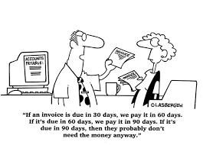
Control Activities – Expenditures
Procurement
Supporting documentation – prior to payment
Coding of expenditures
System rejects
Ledgers are reconciled
Open purchase orders
Significant estimates
W-9
Positive pay

Slide 18
Control Activities – Payroll
Restricted access
Master file change log
Time sheet approvals
Withholding tables & W-4 Changes
Payroll registers – comparisons
Reconciliation of quarterly/annual payroll returns
PTO accruals – complex spreadsheets

Slide 19
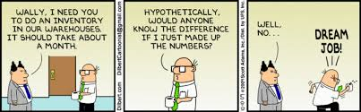
Control Activities – Inventory
Sub-ledger reconciled
Valuations
Authorized access
Inventory counts
Variance– investigated
Obsolescence - estimate

Slide 20
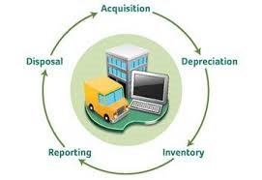
Control Activities – Capital Assets
Capital budgets - acquisitions
Do they still exist?
Secure
Capitalization policy - communicated
Reconciliations, sub-ledgers
Contributed assets
Compliance – tracking
Depreciation
Disposals

Slide 21
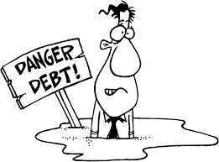
Control Activities – Debt
Compliance with covenants
Current and advanced refunding
Unspent bond proceeds
Debt and lease commitment schedules

Slide 22
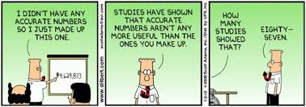
Control Activities – Fund Balance/Net Position
Written fund balance policy
Supporting documentation
Reviewed and approved
Roll-forward

Slide 23
Control Activities – Grants
Identifying federal, state, and other awards
Segregation of receipts and expenditures
Reconciliation of grant financial report
Unallowable costs
Tracking property and equipment
Matching
Procurement
Sub-recipient monitoring
  Communication – type of funding & findings
Timely submittals

Slide 24
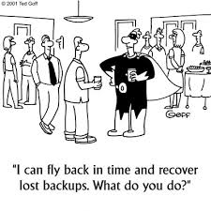
Control Activities – Information Technology
Evaluated regularly
Backup and retention policy
Terminated employees
User rights
Passwords
Restricted access
Software implementation “ Commitment to Training”

Slide 25
Control Activities – Financial Close
Authoritative guidance
Estimates
Budget to actual
Journal entries - segregation
Disclosure checklists – GFOA
Formal closing procedures – timely
Government-Wide

Slide 26
Resources
The Green Book – US Government Accountability Office (“GAO”) - Standards for Internal Control in the Federal Government, September 2014 –
    http://www.gao.gov/greenbook/overview
Committee of Sponsoring Organizations of the Treadway Commission (“COSO”) – www.coso.org
Thomson Reuters – Practitioners Publishing Company (“PPC”)
Government Finance Officers Association (“GFOA”)– Best Practices - www.gfoa.org

Slide 27

QUESTIONS

Slide 28
Contacts
Israel Gomez, CPA, Partner
  israel.gomez@kmccpa.com
Marc Grace, CPA, Manager
  marc.grace@kmccpa.com

