Slide 1
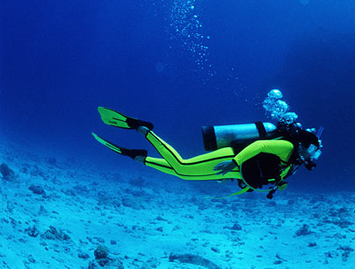
Diving into the 2013 COSO Framework
Presented by: Ronald A. Conrad

Slide 2
Objectives
Obtain an understanding of why the COSO Framework has been updated
Understand how the framework has changed
Identify the Principles of the new framework and the associated Points of Focus
Consider how the new Framework may affect your organization
Discuss next steps to implement the new framework
2

Slide 3
General Definition of Internal Control
Process for assuring achievement of objectives in operational effectiveness and efficiency, reliable reporting and compliance
Everything that controls risks to an organization
Means by which resources are directed, maintained and measured
Important role in preventing and detecting fraud and protecting resources
Continues to expand and change
New controls address new ways of breaking old controls
Enhancements of methodologies to address, such as
COSO framework
Fraud triangle
3

Slide 4
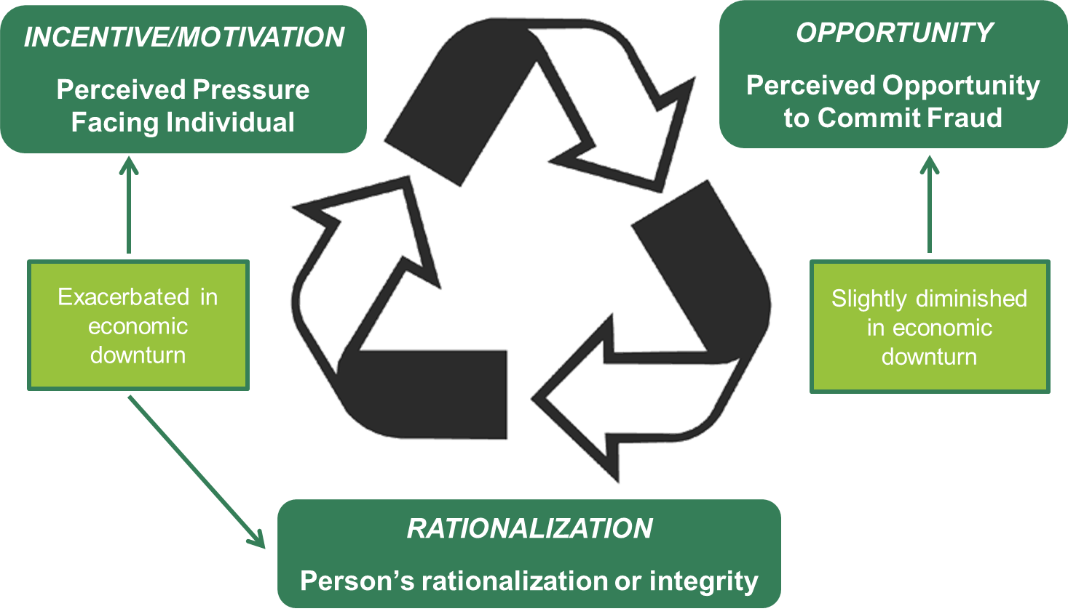
The Fraud Triangle
4

Slide 5
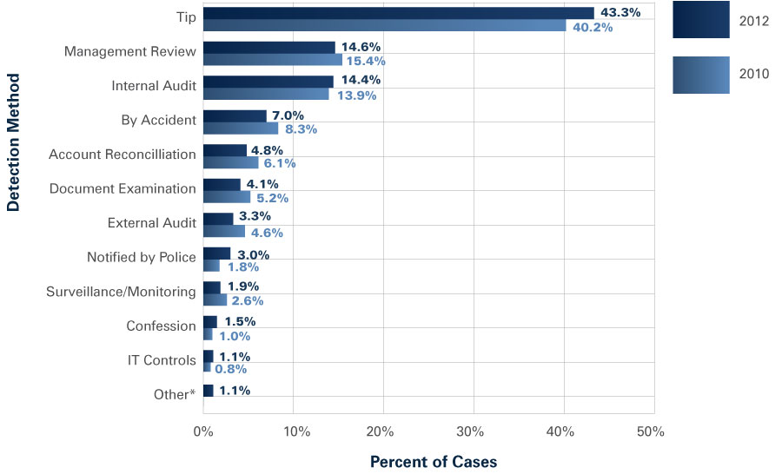
Internal Control---Fraud Detection Methods
5

Slide 6
Internal Control-New Draft Florida House and Senate Bill
House and Senate Bills currently in draft form that will add a new subsection 3 to Florida Statute 218.33, requiring local governments to establish and maintain internal controls designed to:
Prevent and detect fraud, waste and abuse
Promote and encourage compliance with laws rules, contracts, grant agreements and best practices
Support economic and efficient operations
Ensure reliability of financial records and reports
Safeguard assets
6

Slide 7
Internal Control for Grants----New Uniform Grant Guidance
The new Super Circular requirements for grants provides that internal controls over grant compliance should be in compliance with
Internal Control Integrated Framework’’, issued by the Committee of Sponsoring Organizations of the Treadway Commission (COSO)
7

Slide 8
Uniform Grant FAQ 200.303-1
Question - Should vs Must and Internal Controls
According to auditing standards, "should" really means "must unless there is a well-documented reason why not". Is this the case in the Uniform Guidance? Does the "should" in section 200.303 referencing guidance provided by GAO and COSO really mean "must"?
Answer –
No. The word “must” is used throughout part 200 to indicate requirements. The word “should” is used to indicate best practices or recommended approaches that the COFAR wanted non-Federal entities to be aware of, but not necessarily required to comply with.

Slide 9
About COSO
Committee of Sponsoring Organizations
Formed in 1985 to sponsor the National Commission on Fraudulent Financial Reporting
AKA the Treadway Commission
Joint initiative of five private sector organizations
Mission
“To provide thought leadership through the development of comprehensive frameworks and guidance on enterprise risk management, internal control and fraud deterrence designed to improve organizational performance and governance and to reduce the extent of fraud in organizations.”
9

Slide 10
COSO - Sponsoring Organizations
10

Slide 11
How Does COSO Help?
Provides a means to apply internal control to any type of entity, regardless of industry or legal structure, at the levels of entity, operating unit, or function
Provides flexibility and allows for judgment in designing, implementing, conducting internal control—can be applied at the entity, operating, and functional levels
A means to identify and analyze risks, and to develop and manage appropriate responses to risks within acceptable levels and with a greater focus on anti-fraud measures
11

Slide 12
COSO is Principles Based
The Framework does not prescribe controls to be selected, developed, and deployed for effective internal control.
An organization’s selection of controls to effect relevant principles and associated components is a function of management judgment based on factors unique to the entity.
12

Slide 13
The Original Framework
First published in 1992
Gained wide acceptance in early 2000s with passage of Sarbanes Oxley
Most widely used internal control framework in U.S.
Widely used around the world
13

Slide 14
COSO Framework (1992)
Categories of Objectives:
Operations – Achievement of an entity’s basic mission and vision
Financial Reporting – Preparation of financial reports for use by external organizations and stakeholders
Compliance – Actions taken to comply with applicable laws and regulations
14

Slide 15
The 5 COSO Components (1992)
Control Environment – Governing Body, Organizational Structure
Risk Assessment – Risk Identification and Analysis
Control Activities – Policies and Procedures, Change Management
Information and Communication – Quality of Information and Effectiveness of Communication
Monitoring – On-going Monitoring, Evaluations
15

Slide 16
Why The Update?
16

Slide 17
Responded to Changes in Business, Operating and Regulatory Environments
Use of, and reliance on, evolving technologies
Changes in business models
Changes and greater complexities of business
Expectations relating to preventing and detecting fraud
Globalization of markets and operations
Expectations for governance oversight
Demands and complexity in laws, rules, regulations, and standards
Expectations for competencies and accountabilities
17

Slide 18
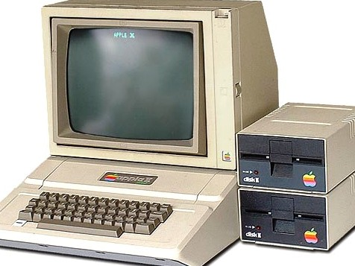
Technology Then and Now
1992 | 2013
18

Slide 19
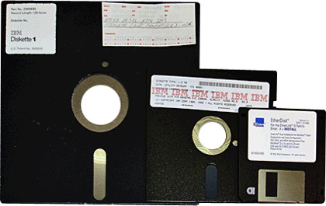
Technology Then and Now
1992 | 2013
19

Slide 20
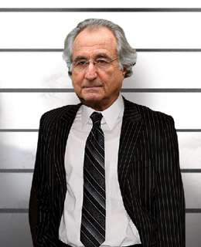
Focus on Fraud
Putting fraud right out in the forefront.
A business's control structure must now address issues of fraud directly.
20

Slide 21
Outsourcing
More companies are outsourcing key portions of their business processes or controls to third parties.
It includes expanded guidance and considerations relating to outside resources, such as third-party processors.
21

Slide 22
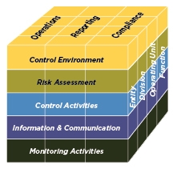
Changes
Update considers changes in business and operating environments
Environments changes... | …have driven Framework updates
Expectations for governance oversight
Globalization of markets and operations
Changes and greater complexity in business
Demands and complexities in laws, rules, regulations, and standards
Expectations for competencies and accountabilities
Use of, and reliance on, evolving technologies
Expectations relating to preventing and detecting fraud
COSO Cube (2013 Edition)
22

Slide 23
Update expected to increase ease of use and broaden application
What is not changing... |  | What is changing...
Core definition of internal control Three categories of objectives and five components of internal control Each of the five components of internal control are required for effective internal control Important role of judgment in designing, implementing and conducting internal control, and in assessing its effectiveness |  | Changes in business and operating environments considered Operations and reporting objectives expanded Fundamental concepts underlying five components articulated as principles Additional approaches and examples relevant to operations, compliance, and non-financial reporting objectives added
23

Slide 24
Core Definition of Internal Control
Retains core definition of internal control
“Internal control is a
process,
effected by an entity’s board of directors, management, and other personnel,
designed to provide reasonable assurance
regarding the achievement of objectives relating to operations, reporting, and compliance.”
24

Slide 25
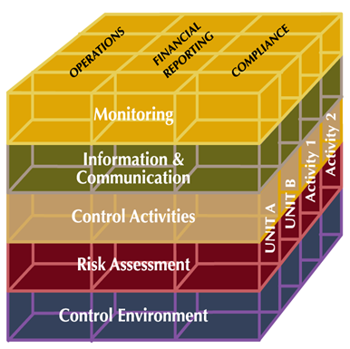
COSO Comparison
COSO Internal Control – Integrated Framework (1992 - 2013)
25

Slide 26
COSO Comparison
COSO Internal Control – Integrated Framework (1992 - 2013)
26

Slide 27
Objectives
Operations Objectives – effectiveness and efficiency of the entity’s operations, including operational and financial performance goals, and safeguarding assets against loss
Reporting Objectives – internal and external financial and non-financial reporting and may encompass reliability, timeliness, transparency, or other terms set forth by regulators, recognized standard setters, or the entity’s policies
Compliance Objectives – adherence to laws and regulations to which the entity is subject
27

Slide 28
Objectives
Reporting objectives may relate to financial or non-financial reporting and to internal and external reporting
 | Financial Reporting | Non-Financial Reporting
External | Annual Financial Statements Interim Financial Statements Earnings Releases | Internal Control Report Sustainability Report Supply Chain / Custody of Assets
Internal | Divisional Financial Statements Cash Flow / Budgets Bank Covenant Calculations | Staff / Asset Utilization Customer Satisfaction Surveys Key Risk Indicator Dashboards Board Reporting
28

Slide 29
Components & Principles
Control Environment
2. Exercises oversight responsibility
3. Establishes structure, authority and responsibility
4. Demonstrates commitment to competence
5. Enforces accountability
Risk Assessment
6. Specifies suitable objectives
7. Identifies and analyzes risk
8. Assesses fraud risk
9. Identifies and analyzes significant change
Control Activities
10. Selects and develops control activities
11. Selects and develops general controls over technology
12. Deploys through policies and procedures
Information & Communication
13. Uses relevant information
14. Communicates internally
15. Communicates externally
Monitoring Activities
16. Conducts ongoing and/or separate evaluations
17. Evaluates and communicates deficiencies
1. Demonstrates commitment to integrity and ethical values
29

Slide 30
Principles
Each principle is suitable to all entities
All principles are presumed relevant except in rare situations where management determines that a principle is not relevant to a component (e.g., governance, technology)
30

Slide 31
Relationship of Objectives & Components
A direct relationship exists between objectives, components and organizational structure
31

Slide 32
Points of Focus
Points of focus may not be suitable or relevant, and others may be identified
Points of focus may facilitate designing, implementing, and conducting internal control
There is no requirement to separately assess whether points of focus are in place
32

Slide 33
Points of Focus
5 Components
17 Principles
81 Points of Focus
33

Slide 34
Principle 1 (control environment)
Demonstrates a commitment to integrity and ethical values
Points of Focus:
Sets the Tone at the Top
Establishes Standard of Conduct
Evaluates Adherence to Standards of Conduct
Addresses Deviations in a Timely Manner
34

Slide 35
Principle 1 Example Questions
Are standards of conduct established and followed?
Do standards cover key areas of risk and control objectives?
Should the standards be modified to address matters that have occurred or may occur?
Is there a whistle-blower policy?
What happens if standards of conduct are not followed?
Are deviations from conduct standards recurring?
35

Slide 36
Principle 2 (control environment)
Exercises Oversight Responsibility
Points of Focus:
Establishes Oversight Responsibilities
Applies Relevant Experience
Operates Independently
Provides Oversight for System of Internal Control
36

Slide 37
Principle 2 Example Questions
Are methods of oversight adequate to timely identify and address matters?
Is the structure for oversight adequate, including independence?
Is there evaluation as to whether oversight is properly functioning?
37

Slide 38
Principle 3 (control environment)
Establishes Structure, Authority and Responsibility
Points of Focus:
Considers All Structures of the Entity
Establishes Reporting Lines
Defines, Assigns, and Limits Authorities & Responsibilities
38

Slide 39
Principle 3 Example Questions
Are structures adequate to provide reasonable assurance control objectives are met?
Are reporting lines clearly established?
Are roles and responsibilities clearly established?
Are control objectives adequately covered by roles and responsibilities?
Is anyone monitoring changes to requirements?
39

Slide 40
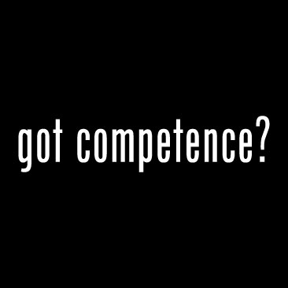
Principle 4 (control environment)
Demonstrates Commitment to Competence
Points of Focus:
Establishes Policies and Practices
Evaluates Competence and Addresses Shortcomings
Attracts, Develops and Retains Individuals
Plans and Prepares for Succession
40

Slide 41
Principle 4 Example Questions
Is the work environment positive?
Is personnel retention appropriate?
Are policies and procedures in place to ensure an environment that furthers competence?
Hiring practices
Training
Collaboration
Job descriptions and policies and procedures manuals
Evaluations and plans for development
Cross-training of functions
41

Slide 42
Principle 5 (control environment)
Enforces Accountability
Points of Focus:
Enforces Accountability through Structures, Authorities and Responsibilities
Establishes Performance Measures, Incentives, and Rewards
Considers Excessive Pressures
Evaluates Performance and Rewards or Disciplines Individuals
42

Slide 43
Principle 5 Example Questions
Is there appropriate reporting and monitoring to ensure accountability?
Is it readily apparent where accountability lies?
Are performance measures adequately established?
Are there appropriate incentives to meet performance measures?
43

Slide 44
Principle 6 (risk assessment)
Specifies Suitable Objectives
Points of Focus:
Reflects Management’s Choices
Considers Tolerances for Risk
Includes Operations and Financial Performance Goals
Forms a Basis for Committing of Resources
Complies with Applicable Accounting Standards
Considers Materiality
Reflects Entity Activities
Complies with Externally Established Standards and Frameworks
Considers the Required Level of Precision
Reflects External laws and Regulations
44

Slide 45
Principle 6 Example Questions
Is a risk assessment program in place?
Are risks identified sufficient to cover control objectives and operational and performance goals?
Are risks periodically evaluated?
Is risk tolerance and costs versus benefits sufficiently considered?
Is a risk assessment formally documented?
45

Slide 46
Risk Assessment
Potential objectives (House and Senate Draft Bill)
Prevent and detect fraud, waste and abuse
Promote and encourage compliance with laws rules, contracts, grant agreements and best practices
Support economic and efficient operations
Ensure reliability of financial records and reports
Safeguard assets
Possible other objectives
Report information within applicable deadlines
Limit negative public perceptions
46

Slide 47
Principle 7 (risk assessment)
Identifies and Analyzes Risk
Points of Focus:
Includes Entity, Subsidiary, Division, Operating Unit, and Functional Levels
Analyzes Internal and External Factors
Involves Appropriate Levels of Management
Estimates Significance of Risks Identified
Determines How to Respond to Risks
47

Slide 48
Principle 7 Example Questions
Is there appropriate personnel involvement to adequately identify risks?
Are risks identified by level of significance?
Is the risk assessment sufficiently comprehensive?
Is there a plan for respond to risks identified?
48

Slide 49
Risk Assessment Considerations
Identification and analysis of risk, including risk due to change and fraud risk
Risks due to regulatory change (e.g. Uniform Grant Requirements, accounting requirements and statutory changes)
Risks related to contract compliance (e.g., grants and debt covenants)
Risks related to personnel changes, off-site communications or structural changes
Risks related to recording of routine transactions (e.g., receipts and disbursements) and non-routine transactions (e.g., journal entries)
Changing risks associated with information technology
49
49

Slide 50
Risk Assessment Considerations
Other typical areas of identified risks
Basic controls over information technology
Debt covenant compliance
Accounting and compliance considerations for new regulatory requirements
Unusual estimates
Related party transactions
Inadequate segregation of duties
Areas particularly prone to public scrutiny
50

Slide 51
Principle 8 (risk assessment)
Assesses Fraud Risk
Points of Focus:
Considers Various Types of Fraud
Assesses Incentive and Pressures
Assesses Opportunities
Assesses Attitudes and Rationalizations
51

Slide 52
Fraud Prevention and Detection Techniques
Train employees in fraud prevention
warning signs of suspicious behavior
procedures for reporting suspicious activities
basic fraud prevention techniques
through live training and ongoing communications
Conduct audits, including high risk areas and surprise audits
Hotlines, mandatory vacations, job rotation
52

Slide 53
Principle 9 (risk assessment)
Identifies and Analyzes Significant Change
Points of Focus:
Assesses Changes in External Environment
Assesses Changes in the Business Model
Assesses Changes in Leadership
53

Slide 54
Principle 10 (control activities)
Selects and Develops Control Activities
Points of Focus:
Integrates with Risk Assessment
Considers Entity-Specific Factors
Determines Relevant Business Processes
Evaluates a Mix of Control Activity Types
Considers at What Level Activities are Applied
Addresses Segregation of Duties
54

Slide 55
Principle 11 (control activities)
Selects and Develops Controls Over Technology
Points of Focus:
Determines Dependency between the Use of Technology in Business Processes and Technology General Controls
Establishes Relevant Technology Infrastructure Control Activities
Establishes Relevant Security Management Process Control Activities
Establishes Relevant Technology Acquisition, Development, and Maintenance Process Control Activities
55

Slide 56
Principle 12 (control activities)
Deploys Through Policies and Procedures
Points of Focus:
Establishes Policies and Procedures to Support Deployment of Management Directives
Establishes Responsibility and Accountability for Executing Policies and Procedures
Performs in a Timely Manner
Takes Corrective Action
Performs Using Competent Personnel
Reassesses Policies and Procedures
56

Slide 57
Control Activities Considerations
Selection and development
Risk considerations
Preventive and detective controls to address identified risks
Levels of involvement
Need for consultation
Controls over technology requirements
Policies and procedures
Timely performance, accountability, prevention and detection controls and corrective actions
57

Slide 58
Principle 13 (information/comm)
Uses Relevant Information
Points of Focus:
Identifies Information Requirements
Captures Internal and External Sources of Data
Processes Relevant Data into Information
Maintains Quality throughout Processing
Considers Costs and Benefits
58

Slide 59
Principle 14 (information/comm)
Communicates Internally
Points of Focus:
Communicates Internal Control Information
Communicates with the Board of Directors
Provides Separate Communication Lines
Selects Relevant Method of Communication
59

Slide 60
Principle 15 (information/comm)
Communicates Externally
Points of Focus:
Communicates to External Parties
Enables Inbound Communications
Communicates with the Board of Directors
Provides Separate Communication Lines
Selects Relevant Method of Communication
60

Slide 61
Principle 16 (monitoring activities)
Conducts Ongoing and Separate Evaluations
Points of Focus:
Consider a Mix of Ongoing and Separate Evaluations
Considers Rate of Change
Establish baseline understandings
Uses knowledgeable personnel
Integrates with Business Processes
Adjusts Scope and Frequency
Objectively evaluates
61

Slide 62
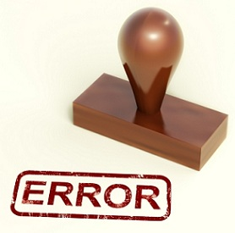
Principle 17 (monitoring activities)
Evaluates and Communicates Deficiencies
Points of Focus:
Assesses Results
Communicates deficiencies
Monitors corrective actions
62

Slide 63
Monitoring Activities-Additional Considerations
Documentation
Scope and frequency
Responsibilities for monitoring
Assessing results
Communicating results
Off-site activities
Compliance inspections
63

Slide 64
COSO Appendix B on OSPs
COSO has a separate Appendix B that discusses application of framework to Outsourced Service Providers (OSPs)
Control environment should provide standards of conduct, tolerance levels, compliance procedures, performance measures
Risk assessment should consider corruption, fraud, IT related matters, interactions with the ISP
Control activities should consider OSP processes and functions and controls related to information provided to OSPs
Information and communication should evaluate adequacy of reporting and communications and complexities
Monitoring should include procedures to evaluate OSPs, such as SSAE16 reports and separate evaluations and reviews
64

Slide 65
COSO Appendix C on Information and Communication
COSO has a separate Appendix C that discusses application of the framework to information technology
Control Environment should assess new IT capabilities, assign appropriate responsibilities and segregation of duties, establish policies and procedures, ensure competent personnel
Risk assessment should consider ability to manipulate information, effectiveness of systems, personnel turnover
Control activities should consider access rights, acquisition, development and maintenance, safeguard controls
Information and communication should assess information retention, external parties, complexity, volume, methods, nature
Monitoring should consider use of IT as an objective method
65

Slide 66
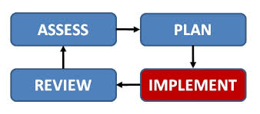
Implementing the 2013 COSO Framework
66

Slide 67
COSO Effective Internal Control
Effective internal control provides reasonable assurance regarding the achievement of objectives and requires that:
Each component and each relevant principle is present and functioning
Present refers to design of internal control
Functioning refers to the conduct of internal control
The five components are operating together in an integrated manner
Effectively reduce, to an acceptable level, the risk of not achieving an objective
External parties are not part of an internal control system
67

Slide 68
Three Dimensions
Objectives
Operations
Reporting
Compliance
5 Components
Control Environment
Risk Assessment
Control Activities
Information & Communication
Monitoring Activities
Organizational Structure
Entity
Division
Operating Unit
Function
68

Slide 69
Components & Principles
Control Environment
Demonstrates commitment to integrity and ethical values
Exercises oversight responsibility
Establishes structure, authority and responsibility
Demonstrates commitment to competence
Enforces accountability
Risk Assessment
Specifies suitable objectives
Identifies and analyzes risk
Assesses fraud risk
Identifies and analyzes significant change
Control Activities
Selects and develops control activities
11. Selects and develops general controls over technology
Deploys through policies and procedures
Information & Communication
Uses relevant information
Communicates internally
Communicates externally
Monitoring Activities
Conducts ongoing and/or separate evaluations
Evaluates and communicates deficiencies
69

Slide 70
How COSO Framework may affect your organization
Comparison of components and principles to current internal controls, considering points of focus, may identify
Additional considerations of control environment
More detailed discussions about risk assessment and documentation of risk assessment
Further consideration of potential fraud risk
Potential additional control activities and monitoring as a result of risk assessment
Further consider controls over Outsourcing to Service Providers
Possible additional considerations related to IT
70

Slide 71
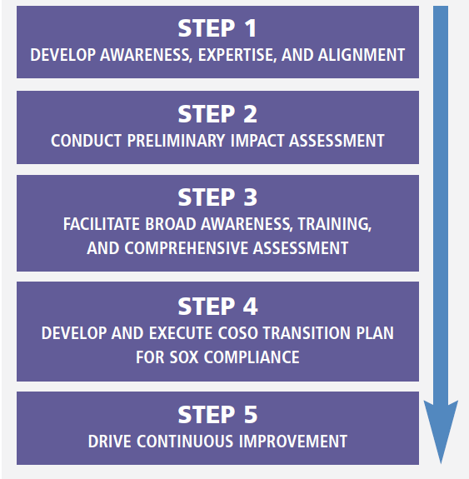
Five Step Transition Plan
71

Slide 72
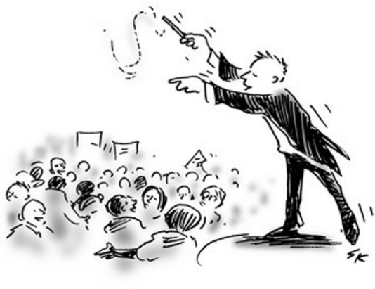
Step 1 – Develop Awareness
Gain senior leadership and board alignment and support
Build awareness and expertise
Educate management
72

Slide 73
Step 2 – Preliminary Impact
One significant factor - how well principles are currently functioning
Map principles to existing controls
Assess gaps where principles are not adequately addressed
73

Slide 74
Step 3 – Facilitate Awareness
Engage broader organization
Compliance efforts may occur centrally, or there may be multiple layers of assessment
Conduct Training
Pressure test preliminary impact assessment
74

Slide 75
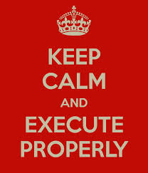
Step 4 – Execute Plan
Phase 1: Documentation and Evaluation
Phase 2: Validation Testing and Gap Remediation
75

Slide 76
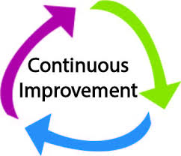
Step 5 – Continuous Improvement
Drive continuous improvement
There’s a difference between an adequate and a best-in-class system of internal control
76

Slide 77
Common Issues
When going through the mapping exercise, organizations do not have controls in place to meet all 17 principles.
Organizations may have controls in place, but they are undocumented / not formalized.
Lack of fraud risk assessment.
Lack of knowledge of outsourcing controls.
77

Slide 78
Limitations of COSO
No such thing as absolute assurance
The framework comments on limitations of internal control, which results from:
Quality and suitability of objectives established as a precondition to internal control
Potential for flawed human judgment in decision-making
Management’s consideration of the relative costs and benefits in responding to risk and establishing controls
Potential for breakdowns that can occur because of human failures (such as simple errors or mistakes)
Possibility that controls can be circumvented by collusion of two or more people
Ability of management to override internal control functions and decisions
78

Slide 79
Ronald A. Conrad – raconrad@cbh.com
79

