Slide 1
Internal Controls in a
Paperless Environment
By Andrew Laflin and Jim Kreiser

Slide 2
“Going Paperless…”
When people hear the phrase “going paperless,” they often assume they will no longer be using paper in daily tasks or even have access to it in their office.
This obviously is not true or practical.
Going paperless means using paper wisely and sparingly, and finding effective alternatives.

Slide 3
“Going Paperless…” – Is it Cost Effective?
Switching from a paper-based work environment to electronic sounds like a headache.
  Maybe you are comfortable with the process
  Maybe you don’t like change
Have you ever thought about the number of paper invoices that come into your accounts payable department each month and a like number of paper checks that go out to vendors.
but consider these statistics…

Slide 4

“Going Paperless…” – Statistics
Organizations spend on average in labor costs:
  $20 to file a document
  $120 to find a misfiled document
  $220 to reproduce a lost document
The average cost to process a single invoice manually is $24. (IOMA)
70% of all accounts payable payments made today are made on paper. It lags most other functional areas in terms of automation.
Of all documents…
  7.5% get lost
  3% of the remainder get misfiled
Professionals spend 5-15% of their time reading information, but up to 50% looking for it.
(Aberdeen Group)

Slide 5
Fundamentals of Internal Controls
**When it comes to going paperless, this can significantly
improve efficiency and enhance your internal controls**
1. Establish prevention procedures
  Identify key areas where your organization is most vulnerable and know who is accountable for each. Determine the types of fraud that may occur and how they would likely be concealed. Then establish internal controls to keep these possibilities from becoming realities.
2. Go paperless
  Prevent "lost" bills, invoices, documents and reduce the risk of manipulation and information theft. You'll also get an audit trail so you know exactly who accessed, viewed, or changed a document.
3. Enforce separation of duties
  Clearly define user access to the data, ensuring single users do not authorize, process, and record financial transactions within the organization.
4. Automate work processes
  Enabling different members of your staff to access bills, invoices, documents; workflow is critical to your productivity. By automating reminders and an audit trail, you ensure that nothing falls through the cracks and that people who are not supposed to be part of the process are kept out.

Slide 6
Fundamentals of Internal Controls (continued)
**When it comes to going paperless, this can significantly
improve efficiency enhance your internal controls**
5. Enforce payment controls
  By segmenting role-based controls, you make sure that no one person has access to information and the ability to edit accounting data (vendor addresses, etc.). Separation of the approval process from payment and of data entry from payment processing is key.
6. Streamline & control check process (incoming and outgoing)
  A single check contains every piece of information needed to access your money. By receiving payments electronically you prevent trips to the bank and protect against checks being improperly deposited.
7. Perform more regular internal audits
  Automated systems make regular audits much easier, creating an
  online audit trail and review of the entry and approval processes.

Slide 7


The “Paperless Plan”
  Overcoming the hurdles & Get Buy In
  Tossing out paper requires cooperation not just from your team, but the organization, and ultimately to go completely paperless need to have buy in from customers, vendors, and 3rd parties.
Start Small
  Which areas do you have the buy in and try a specific process (maybe banking since easy to get online statements, maybe billing if your software can attach billing detail to it…).
  While vast segments of the finance function have gone electronic, accounts payable remains one of the last to convert. Per IOMA, they call this the “paper tsunami.” (Don’t do account payable first, do something small and that you can get your arms around).
  It can be as simple as taking the paperless concepts you already embrace in your personal life (e.g. online bank statements, credit card statements) and employing that same mindset to your office.
  Maybe you like the idea of adding a second computer monitor to help cut down the number of documents you print.

Slide 8
The “Paperless Plan” (continued)
Document the Process
  Document the workflow processes from beginning to end so you know how you want it to look and be done (this will be great for laying out the internal controls).
  Include Records Retention Policy & Clean up the hard copies for each area as you go through the process.
Go Gradual
  Devise a timeline, include meetings, follow up, pros, cons on each process.
Perform Annual Audits on each Paperless Process
  Review to make sure documentation is in line with actual process, savings, costs, efficiencies, inefficiencies.

Slide 9
Best Practices around Financial Areas
  Clinging to paper, inflates invoice processing costs, ups payment errors and increases the chances of payment fraud. You may miss opportunities to take early payment discounts, miss payment deadlines completely, incurring late fees. All this ties up cash when it could be put to better use growing the organization or spending on program expense.
Accounts Payable
  Scan invoices, attach to check requests, ability to route check requests for approval electronically…
  Dual check signers don’t need to be in the same building or even same city to approve checks…
Accounts Receivable
  Scan invoices, backup; send documents via email instead of snail mail…
Banking
  Online access, EFTs, ACHs, check scanners instead of running to the bank…
Payroll
  Online timesheets & approval system…

Slide 10
Current Trends
Implementing Software
  Cloud-Based Accounting System
    Attach supporting documentation for Journal Entries, Accounts Payable, Accounts Receivable, and Banking
    Typically web-based systems are hosted at top tier data warehouses with IT infrastructure comparable to Fortune 100 companies. Many of these companies provide everything from onsite back-ups to disaster recovery plans. This is a much more effective storage facility than rooms full of filing cabinets with no backup.
  Writing, Editing and Office Work
    Leverage Adobe and Microsoft Software, users can mark up documents and add notes just like you would on paper.
  Storage and Archiving Processes
    Utilize 3rd party archival/storage, or current trends and costs of data/disc storage have become increasingly inexpensive
Multiple Computer Monitors
  Makes research, drafting, and review much more efficient
Office Floor Copier/Scanner VS Individual Desktop Scanners
Notes:
IOMA – Institute of Management & Administration

Slide 11

“Going Paperless” – is this for you…
We are all creatures of habit and this can seem like an overwhelming process. Just remember, going paperless doesn’t have to mean a complete overhaul of your world.

Slide 12
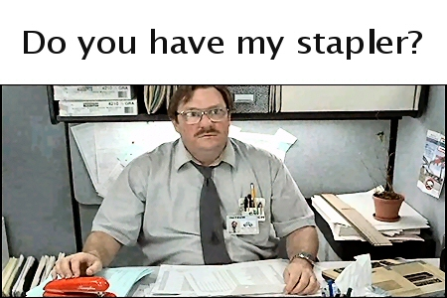
Audit Considerations
Without paper to hold onto and look at, how can the external auditor get comfortable with internal controls over significant transactions classes and with material balances reported on the f/s?

Slide 13
Audit Considerations, continued
Tests of controls include the following:
  Inquiries of appropriate personnel
  Observation of application of the control
  Inspection of documents, reports, or electronic files indicating performance of the control
  Walkthroughs
  Reviews of reconciliations and similar bookkeeping routines
  Re-performance of the application of the control

Slide 14
Audit Considerations, continued
Application controls apply to the processing of individual transaction applications (such as payroll and purchases) and relate to the use of IT to initiate, authorize, record, process, and report transactions or other financial data. Application controls help ensure that transactions occurred, are authorized, and are completely and accurately recorded and processed. Examples include edit checks of input data and numerical sequence checks
Application controls may be performed by IT, referred to as automated controls, or by individuals, referred to as user controls
Notes:
User controls might include checks of the completeness and accuracy of computer output against source documents or other input and manual follow-up of exception reports. For example, a computerized payroll system might calculate all debit and credit amounts from transaction data and a master file. The user control would be to manually check the accuracy of the output produced by the computer by recomputing amounts such as gross pay. User controls also include certain reconciliation and processing controls over computer-generated data, such as reconciling subsidiary ledgers to control accounts, and accounting for the sequence of source documents. The effectiveness of user controls such as reviews of computer-produced exception reports may depend on the accuracy of not only the review, but also of the information in the report. Thus, as discussed in paragraph 606.18, if the auditor tests the manual follow-up activities, the auditor should also determine whether it is necessary to test the accuracy of the computer-produced reports.
606.17 Test Automated Application Controls and Manual Follow-up Activities
Some auditors may determine it is necessary to test automated application controls and manual follow-up activities. Because IT processing is inherently consistent, the auditor may be able to limit the testing of automated application controls to one or a few instances of the control application. In that case, the auditor needs to perform tests of controls to determine that (1) the automated control is functioning effectively and (2) the control continues to function effectively. Generally, an automated control will continue to function effectively unless the program or related stored data are changed. Therefore, to reduce the extent of application controls testing, the auditor can perform tests to determine that relevant general controls are operating effectively during the period. When obtaining audit evidence on operating effectiveness of related general controls, tests might include determining that the authorized version of the program is used to process transactions, that unauthorized changes to the program are not made, and that program changes are subject to appropriate program change controls. Tests of general controls are discussed further beginning in paragraph 606.20.
606.18 When applicable to the relevant assertion, the auditor normally also tests manual follow-up activities (for example, the activities used to follow up on items listed in an exception report). The follow-up activities include investigation and correction of the exception items. (Paragraph 606.32 gives some examples of tests of manual follow-up activities.) If manual follow-up activities are tested, the auditor should consider whether those activities depend on indirect computer-related controls. For example, if a client's procedures for following up on exception reports (such as unmatched documents or past due accounts) are based on computer reports, such procedures depend on programmed controls to ensure accuracy. Such situations may require tests of both programmed controls and manual follow-up procedures to avoid placing inadvertent reliance on the computer. The auditor may either test the accuracy of the computer-produced exception reports (for example, does the report include past-due accounts?) or test the client's controls that ensure the computer-produced reports are accurate.

Slide 15
Audit Considerations, continued
Let’s look at how tests of operating effectiveness of internal controls and substantive testing over a significant audit area – General A/P Disbursements – could be achieved in a paperless environment.

Slide 16
Audit Considerations, continued
Key Controls: Listing of designated reviewers are programmed into the system and updated regularly based on access rights set up in the system. As P.O.s are generated in the system, the designated reviewer is notified via email indicating the necessary approval required. An invoice cannot be processed for payment unless it is matched with an approved P.O.
Testing Step: Observation, re-performance, inspection of documentation (invoice)

Slide 17
Audit Considerations, continued
Key Controls: Check signers' signatures are stored within the system and are electronically added by ??? once payment is ready for processing (has gone through review and approval for payment). No checks can be manually processed and must go through the system. In addition, the system automatically assigns and generates check numbers and does not allow entry of duplicate invoice numbers. Check numbering sequence cannot be altered by anyone. BOA Positive Pay is utilized whereby a transmittal file is generated and uploaded to BOA containing all checks issued for a specific time period. A/P staff cannot alter the Safe Pay file. The A/P Supervisor is notified by BOA if any checks received by BOA do not match the transmittal file.
Testing Step: Observation, inspection of documentation (check images) corroborative inquiry, walkthrough

Slide 18
Audit Considerations, continued
Substantive testing includes analytical procedures search for unrecorded liabilities, both of which do not require reviewing paper documents
NO PAPER REQUIRED TO COMPLETE OUR AUDIT PROCEDURES!
Notes:
analytical procedures to test existence, accuracy/classification, and presentation assertions pertaining to operating expenses and search for unrecorded liabilities to test obligations, completeness, and cutoff assertions

Slide 19
Audit Considerations, continued
Reducing paper over the payroll process
  Replace manual timesheets with electronic timekeeping system
  Do you really need to print out that 400 page pay register each pay period, just so the Payroll Manager can review it and manually sign off on the document?
Potential obstacles for local governments: cost of implementation…any other obstacles?
Potential concerns of your auditor if paperless: internal controls over approval of time and processing of payroll and recording to the GL

Slide 20
Definition of a Secure System
“A secure system is one we can depend on to behave as we expect.”
  Source: “Web Security and Commerce”
  by Simson Garfinkel with Gene Spafford
Confidentiality
Integrity
Availability
Notes:
Sans:
Data from over 6,000 Intrusion Prevention Systems
Data from over 9,000,000 systems (Qualys scans)
Trustwave:
Analysis of 200 investigations
Analysis of 1,800 penetration tests

Slide 21
Three Security Reports
Trends: Sans 2009 Top Cyber Security Threats
  September 2009
  http://www.sans.org/top-cyber-security-risks/
Intrusion Analysis: TrustWave
  January 2010 and April 2011
  https://www.trustwave.com/GSR
Intrusion Analysis: Verizon Business Services
  July 2010 and April 2011
  http://securityblog.verizonbusiness.com/2011/04/19/2011-data-breach-investigations-report-released/
Notes:
Sans: Outside → In attempts
Data from over 6,000 Intrusion Prevention Systems
Data from over 9,000,000 systems (Qualys scans)
Trustwave: Successful breach analysis (PCI related)
Analysis of 200 investigations
Analysis of 1,800 penetration tests
Verizon: Successful breach analysis (in conjunction with secret service)

Slide 22
SANS – Client Side Vulnerabilities
Client side vulnerabilities
  Missing operating system patches
  Missing application patches
    Apple QuickTime
    Java Vulnerabilities
    MS Office Applications
    Adobe Vulnerabilities (PDF, Flash, etc…)
Objective is to get the users to “Open the door”

Slide 23
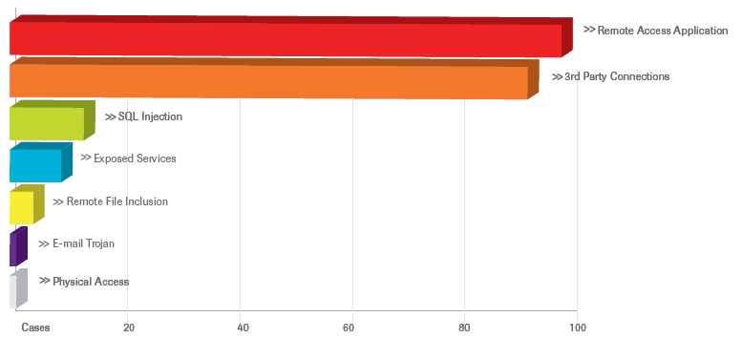
TrustWave – Intrusion Analysis Report
Top Methods of Entry Included:
Top Methods of Entry Included:
Remote Access Applications [45%]
  Default vendor supplied or weak passwords [90%]
3rd Party Connections [42%]
  MPLS, ATM, frame relay
SQL Injection [6%]
  Web application compromises [90%]
Exposed Services [4%]

Slide 24
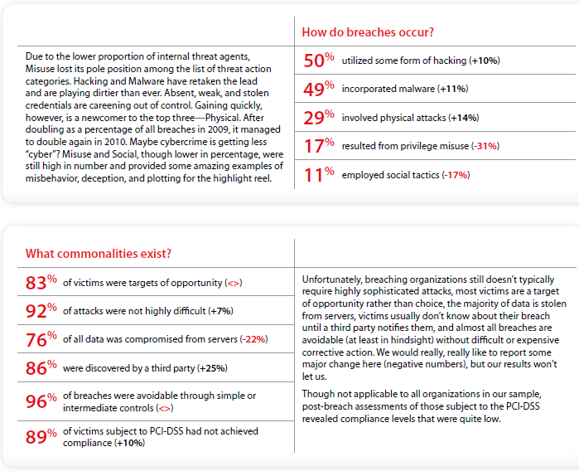
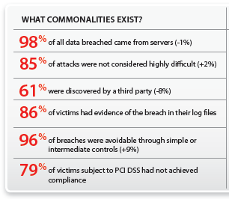
Verizon 2010 and 2011

Slide 25
Network Security – Trends & Implications
Statistics on Data Breaches:
73% resulted from external sources
18% were caused by insiders
- - - -
39% implicated business partners
30% involved multiple parties
- 2008 Data Breach Investigations Report conducted by The Verizon Business Risk Team
Notes:
Paint a picture:
Significant attacks against a “victim group” that is woefully unprepared.
Costs are extremely high, unprecendented.
Weaknesses at customers are being exploited.
Tremendous strain on business relationships.

Slide 26
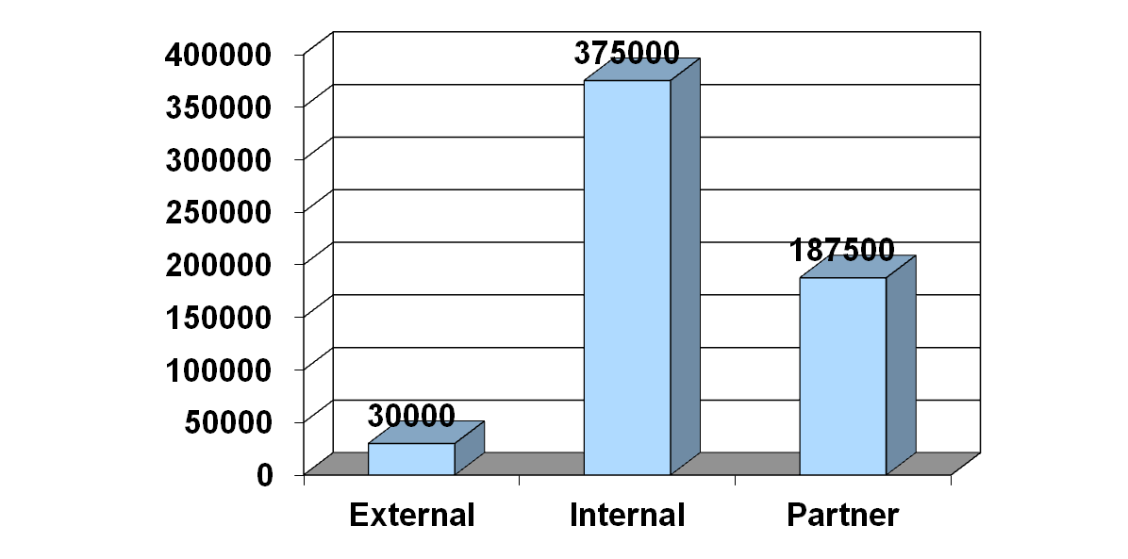
Insider Threats and Risks
While ‘attacks’ and breach attempts as a percentage of attempts are trending towards external factors, the depth of attacks from insiders are generally of greater impact:
Median Number of Records Compromised
2008 Data Breach Investigations Report conducted by
The Verizon Business Risk Team

Slide 27
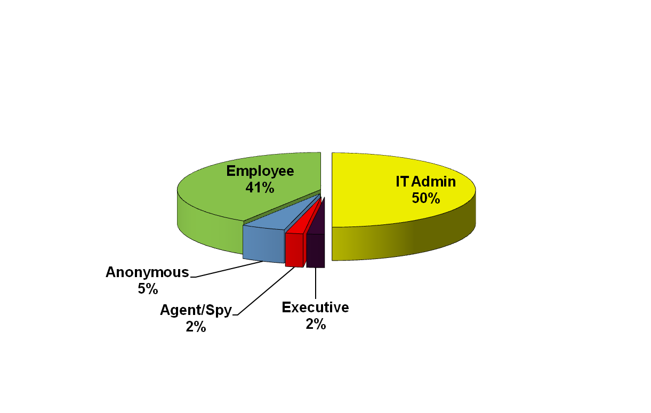
How do hackers and fraudsters break in?
The common internal sources of IT Fraud:
2008 Data Breach Investigations Report conducted by
The Verizon Business Risk Team
Notes:
Back to the Future: pre-text phone calls
Posing as a vendor
Posing as staff (someone in IT, HR, Administration…)
Posing as student/alumni/donor
Email spear Phishing
Attacks to harvest credentials
Attacks to compromise the workstation
Click here to claim your winnings
The online survey from the HR department
Install this critical software update

Slide 28
Impact of Effective IT General Controls
IT General Controls are policies and procedures that relate to many applications and support the effective functioning of application controls by helping to ensure the continued proper operation and integrity of information systems. IT general controls are designed to:
  Allow for changes to systems, databases, and applications to be properly authorized, tested, and approved before they are implemented
  Allow for only authorized persons and applications to have access to data and perform specifically defined functions (e.g., inquire, execute, update).
IT General Controls (ITGCs) provide:
  The base of support for reliance on application and IT dependent manual controls (e.g., reports) related to significant applications
  Basis for management controls and determinations relative to monitoring, risk assessment and other audit & operational considerations
ITGCs Include:
Logical Security, Change Control, and certain Operations controls (e.g., backup and recovery, job scheduling, physical/facility controls)

Slide 29
ITGC Examples
Logical Security Controls
Authorization of user access (internal and external)
Appropriateness of user rights
Segregation of duties
Security parameters in operating system
Password parameters
Security software settings
Security violation logging
Program Change Controls
Authorization and Approval of program changes
Testing/Quality Assurance
User involvement and sign-off
System Development Life Cycle (SDLC)
Source Code Control software – access restrictions & version control
Emergency Changes approvals
Segregation of duties, including programmer access

Slide 30
Security = Culture!!
Security is a BUSINESS issue, NOT a technical issue!!
Objectives:
  Confidentiality
  Integrity
  Availability
Strategy:
  Administrative Policies / Procedures
  Physical Access Controls
  Technical Security Controls

Slide 31
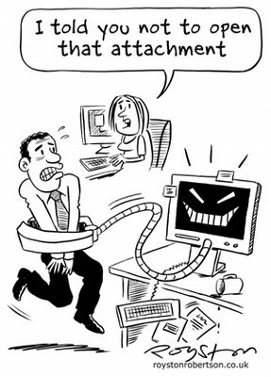
Nine Things Every Organization Should Have
Strong Policies -
  Email use
  Website links
  Removable media
  Users vs Admin
Notes:
We are seeing a lot of clients with Policies geared towards Privicy rule. Not enough on the Security Rule.
We are also seeing many clients that have not properly documented why they are not implementing Addressable Rules
Vendors often have full/pervasive access with few controls or monitoring enforced on them

Slide 32
Keys to Mitigate Risk
2. Defined user access roles and permissions
  Principal of minimum access and least privilege
  Users should NOT have system administrator rights
    “Local Admin” in Windows should be removed (if practical)
Notes:
We are seeing a lot of clients with Policies geared towards Privicy rule. Not enough on the Security Rule.
We are also seeing many clients that have not properly documented why they are not implementing Addressable Rules
Vendors often have full/pervasive access with few controls or monitoring enforced on them

Slide 33
Keys to Mitigate Risk
Hardened internal systems (end points)
  Hardening checklists
  Turn off unneeded services
  Change default password
  Use Strong Passwords
Encryption strategy – data centered
  Email
  Laptops and desktops
  Thumb drives
  Email enabled cell phones
  Mobile media

Slide 34
Keys to Mitigate Risk
Vulnerability management process
  Operating system patches
  Application patches
  Testing to validate effectiveness

Slide 35
Keys to Mitigate Risk
Well defined perimeter security layers:
  Network segments
  Email gateway/filter
  Firewall – “Proxy” integration for traffic in AND out
  Intrusion Detection/Prevention for network traffic, Internet facing hosts, AND workstations (end points)
Centralized audit logging, analysis, and automated alerting capabilities
  Routing infrastructure
  Network authentication
  Servers
  Applications
  Security unit vs. IT Admins/operations
Notes:
Tools range from open source to very mature robust product offerings
Can be structured to run not only as external IDS, but also on internal segments
Can utilize “smart” devices to have automated actions/responses to perceived “attacks” or events
Tools for wireless also exist

Slide 36
Keys to Mitigate Risk
Defined incident response plan and procedures
  Be prepared
  Including data leakage prevention and monitoring
  Forensic preparedness

Slide 37
Keys to Mitigate Risk
Know / use Available Tools
  Multi-factor authentication
  Dual control / verification
  Out of band verification / call back thresholds
  ACH positive pay
  ACH blocks and filters
  Review bank interfaces and contracts relative to all these
  Monitor account activity daily
  Isolate the PC used for wires/ACH
    Segment network for connections to banks, payroll providers, etc. and monitor access to initiate such interfaces

Slide 38
Keys to Mitigate Risk
IT Risk Management Program/Processes
  Are formal IT risk assessment and/or compliance programs/processes in place?
    IT Risk Governance
    Minimum Security Baseline Configurations/Standards
    IT Internal Audit reviews/enforcement
  Integration of identify theft risk considerations (i.e. Red Flags, HIPAA)
  Annual program updates and risk assessment updates based on corporate projects, strategy, and IT changes
  Is there a formal IT strategic plan within the organization?
    Align risks and evaluate/measure risks accordingly
  Define formal IT KPIs for review and monitoring

Slide 39
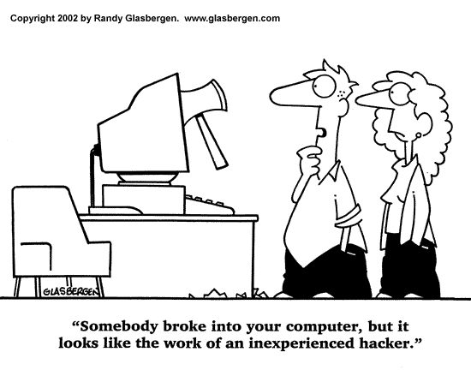
Keys to Mitigate Risk
Test, Test, Test
  Penetration testing
    Internal and external
  Social engineering testing
    Simulate phishing
  IT General Control testing
    Test the tools within your organization
    Test internal processes

Slide 40

Questions?
Go Paperless, Go Green

Slide 41
Questions?
Jim Kreiser, Principal
IT & Risk Management Services
james.kreiser@claconnect.com
(717)558-0860
Andrew Laflin, Manager
Assurance Services
andrew.laflin@claconnect.com

