Slide 1
THE RISKS AND PERILS OF OCCUPATIONAL FRAUD
FGFOA – Central Florida Chapter Presentation
By
Andrew Laflin, CPA
CliftonLarsonAllen LLP

Slide 2
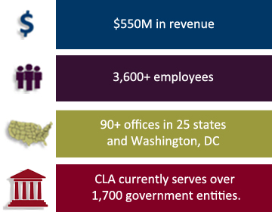
CliftonLarsonAllen- Who We Are
Top ten certified public accounting and consulting firm nationally
More than 90 locations nationwide; seven locations in Florida
Florida practice consists of over 50 professionals with experience serving governmental entities
Public Sector Group, which includes state and local government, is our largest industry sector, both nationally and statewide

Slide 3
CliftonLarsonAllen- Consulting Services Package
Our audit services include the following:
  Information Systems (IS) controls review performed by Information Security Services specialists
  Provide a high level assessment of current enterprise risk management (ERM) capabilities by our ERM specialists.
  Perform detailed internal controls review over significant transaction processes
  Telecom expense analysis – provide recommendations to reduce telecom costs
Notes:
Information Systems (IS) controls review performed by Information Security Services specialist focused to identify and evaluate internal controls and security features implemented by management which protect the integrity of transactions and data, with potential direct impact to financial reporting
For local governments with self-insured medical plans, our healthcare specialists will perform plan & PBM contract reviews, including benchmarking of performance guarantees, audit rights, and service level and reporting metrics, as well as internal controls review and assessment regarding provider SSAE 16 reports and plan and contract/vendor management and monitoring processes
Provide a high level assessment of current enterprise risk management (ERM) capabilities by our ERM specialist. We will perform this review based on our understanding of leading ERM practices, and key elements of ERM as defined by ERM frameworks such as COSO
Prepare a benchmark report of the local government’s municipal pension plan, comparing key attributes, including investment performance and fees paid, to other local government pension plans

Slide 4
Occupational Fraud
Presentation Focus: Occupational Fraud
Definition: The use of one’s occupation for personal enrichment through the deliberate misuse or misapplication of the employing organization’s resources or assets.
Occupational Fraud is far and away the largest source of fraud loss
Source – 2012 Report to the Nation on Occupational Fraud and Abuse

Slide 5
Objectives
At the end of this session, you will be able to:
Understand the latest fraud risks affecting your local government
Identify actual instances of fraud, namely theft of cash, that have recently occurred within cities, counties, and other local governments
Learn about what internal control activities could have been in place to prevent the fraud from occurring or at least detect the malfeasance earlier
How ‘big’ is Fraud? Typical organization loses 5% of revenues per year due to fraud. Translates to estimated $3.5 Trillion Worldwide*
* Source – 2012 Report to the Nation on Occupational Fraud and Abuse

Slide 6
Research Tools
To research your organization’s likely risks given industry and size look to The 2012 ACFE Report to the Nation
  Best source to research organizational exposure by industry and firm size; 2012 version available online free at http://www.acfe.com/uploadedFiles/ACFE_Website/Content/rttn/2012-report-to-nations.pdf

Slide 7
Types of Occupational Fraud - Definitions
Occupational Fraud can be broken down into three main categories:
  Corruption schemes, in which an employee misuses his or her influence in a business transaction in a way that violates his or her duty to the employer in order to gain a direct or indirect benefit (e.g., schemes involving bribery or conflicts of interest)
  Financial statement fraud schemes, in which an employee intentionally causes a misstatement or omission of material information in the organization’s financial reports (e.g., recording fictitious revenues, understating reported expenses or artificially inflating reported assets)
  Asset misappropriation schemes, in which an employee steals or misuses the organization’s resources (e.g., theft of company cash, false billing schemes or inflated expense reports)

Slide 8
Who Commits Fraud (All Industries)?
Male or female?
Over 40 or under 40?
Employees, managers, or executives?
What was the most common position held by the fraudster?
High school graduate and some college, bachelor’s degree, or post-graduate degree?
Notes:
Perpetrators with higher levels of authority tend to cause much larger losses. The median loss among frauds committed by owner/executives was $573,000, the median loss caused by managers was $180,000 and the median loss caused by employees was $60,000.
Approximately 42% of fraudsters were employees, 38% were managers and 18% were owner/executives.
Males – 65% Females – 35%; One of the most interesting findings in our Report each year is the fact that male fraudsters tend to cause losses that are more than twice as high as the losses caused by females. In our 2012 study, the median loss in a scheme committed by a male was $200,000, while the median loss for a female was $91,000.
Less than 26=5.8%; 26-30=9.8%; 31-35=16.1%; 36-40=18%; 41-45=19.6%; 46-50=13.5%; 51-55=9%; 56-60=5.2%; >60=3.1%
Tenure: Approximately 42% of occupational fraudsters had between one and five years of tenure at their organizations. Meanwhile fewer than 6% of perpetrators committed fraud within the first year on the job. We continue to see that tenure has a strong correlation with fraud losses. Individuals who have worked at an organization for a longer period of time will often enjoy more trust from their supervisors and co-workers, which can mean less scrutiny over their actions.
Postgraduate degree=16.9%; College degree=36.9%; some college=20.5%; high school graduate or less=25.3%
Frequency by Position: Accounting=22%; Operations=17.4%; Sales=12.8%; Executive/Upper Management=11.9%; Customer service 6.9%; Purchasing=5.7%; Warehousing/Inventory=4.2%; Finance =3.7%; IT=2%; Manufacturing/Production=1.9%; BOD=1.4%; HR=1.2%; Marketing=1.1%

Slide 9
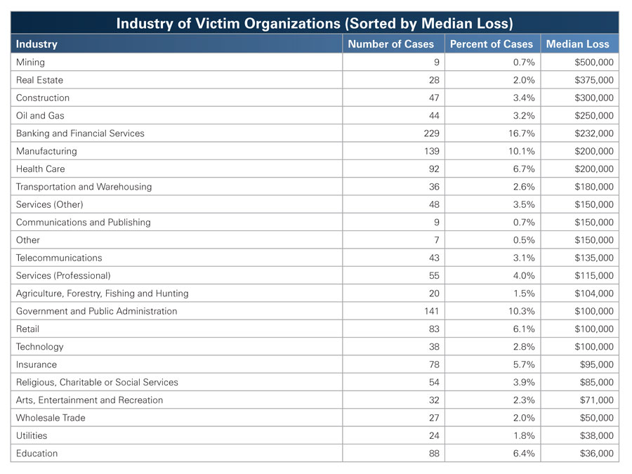
Types of Frauds and Frequency by Industry
Source – 2012 Report to the Nation on Occupational Fraud and Abuse

Slide 10
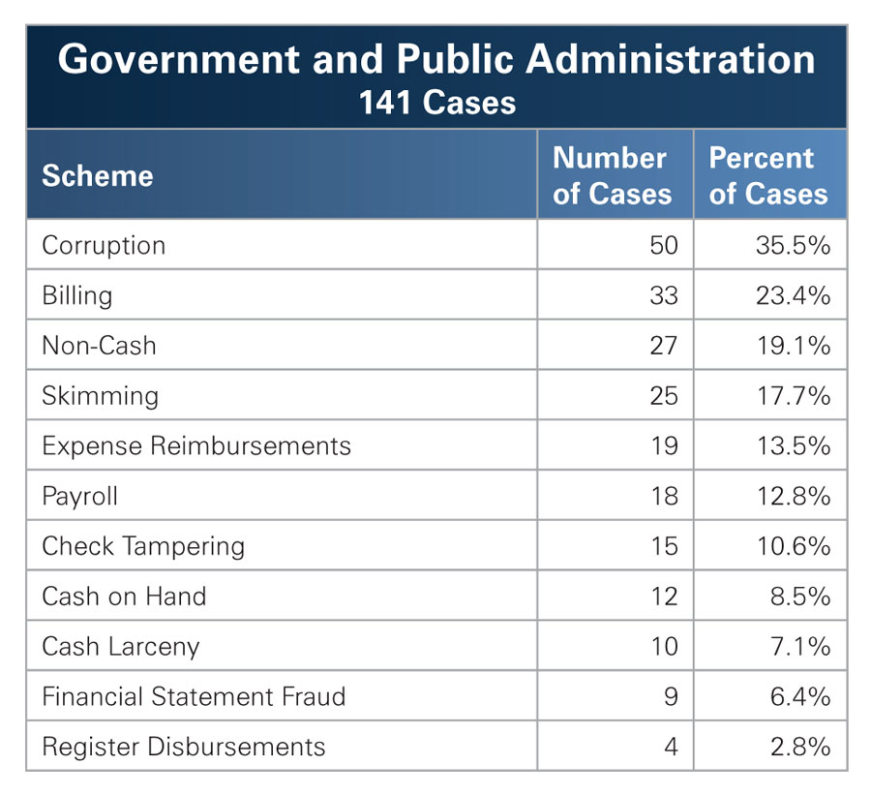
Types of Frauds and Frequency – Local Governments
Source – 2012 Report to the Nation on Occupational Fraud and Abuse

Slide 11
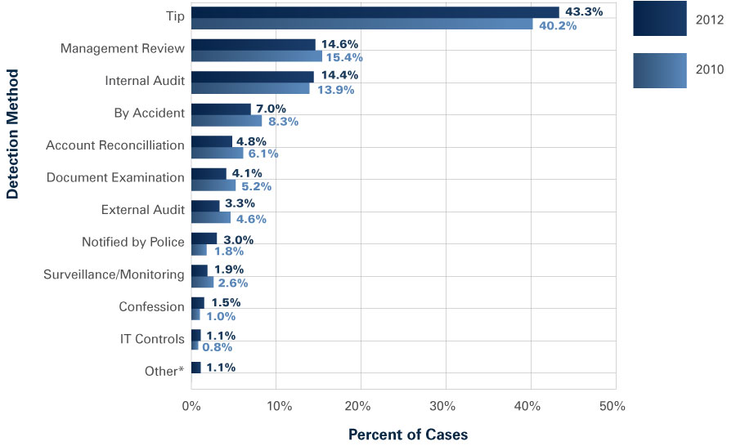
Anti-Fraud Measures
Source – 2012 Report to the Nation on Occupational Fraud and Abuse

Slide 12
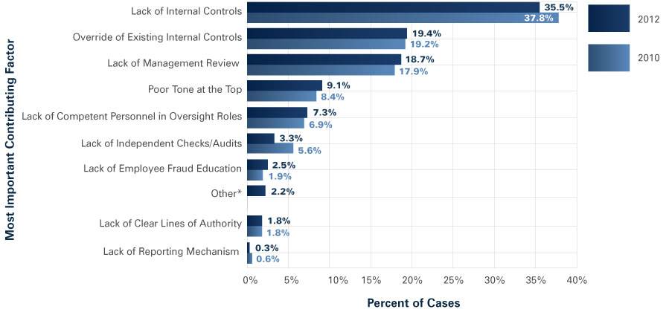
Factors that Contribute to/Allow Fraud
Primarily internal control weaknesses:
Source – 2012 Report to the Nation on Occupational Fraud and Abuse

Slide 13
Why Should We Care?
Why Should Local Governments Be Concerned About Fraud?

Slide 14
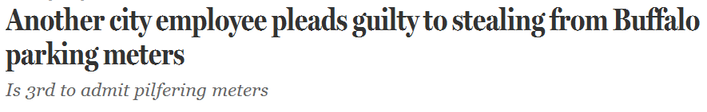
“Newsworthy” Story #1
Stealing quarters apparently isn’t just for the birds

Slide 15
“Newsworthy” Story #1
Francis Tronolone, parking meter mechanic, admitted to stealing $9,000 over 10 year period
All thefts have amounted to at least $234,000
Lawrence Charles admitted to stealing $15,000 in quarters over an 8 year period (sentenced to 6 months in prison)
Charles blamed his wrongdoing on a “culture of corruption” that existed in the parking enforcement division
Discovery: review of parking meter revenues revealed a dramatic disparity between $$$ collected from individual meters and $$$ collected from pay-and-display machines
Notes:
inspected some of the meters and found many of them rigged so quarters would remain in the upper compartment instead of flowing into the lower compartment.
The defendant would carry a cooler, the type of cooler you might use to carry your lunch, and fill it with quarters

Slide 16
Story #1 – What Did we Learn
Better tone at the top!
Anonymous tip line
Periodic analytical reviews of revenues received from various sources and investigate anomalies
Minimize cash collections with no means of reconciliation
  Employee background checks
Notes:
Cash skimming is more difficult to detect or prevent misappropriation than cash larceny
Do not accept cash payments from customers if possible
Implement cash register and/or receipting system for all instances of cash/checks received
Generate an exception report that lists all voided transactions in a given day; require backup documentation to justify each void

Slide 17
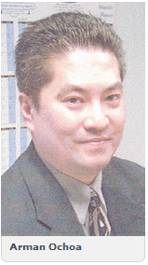
“Newsworthy” Story #2
University Heights Finance Director scandal in Cleveland, OH
  According to a 2008 audit of the city’s finances by the state auditor’s office, released in February 2010, Ochoa received unearned payroll advances in the amount of $69,796 from the city between 2005 and 2008
  Sentenced to one year probation:
Notes:
Michael Goldberg, Ochoa’s lawyer, said Ochoa never attempted to commit a “technical” theft, and he doesn’t consider what his client did to be a theft offense.
“He advanced himself money from the city’s payroll and then immediately initiated a deduction from the payroll so the city would be paid back,” Goldberg said.
He also was required to pay the court costs of $238. In 2010, he paid full restitution of the $71,292 he took from the city in unearned payroll advances and vacation leave overpayments.

Slide 18
“Newsworthy” Story #2
Michael Goldberg, Ochoa’s lawyer, said Ochoa never attempted to commit a “technical” theft, and he doesn’t consider what his client did to be a theft offense.
“He advanced himself money from the city’s payroll and then immediately initiated a deduction from the payroll so the city would be paid back,” Goldberg said.
He also was required to pay the court costs of $238. In 2010, he paid full restitution of the $71,292 he took from the city in unearned payroll advances and vacation leave overpayments.

Slide 19
Story #2 – What Did we Learn
Anonymous tip line
Employee training on ethical behavior and taking proper action when confronted with unreasonable supervisory requests
Adequate review process over payroll transactions
  Remove reviewer’s administrative access to payroll system. Access rights should be read-only.

Slide 20
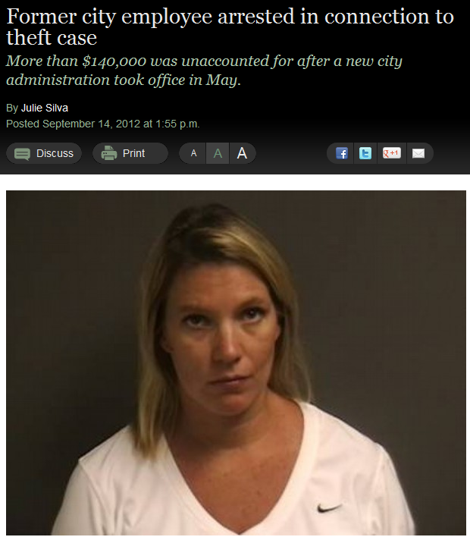
“Newsworthy” Story #3
City of Gregory scandal in Corpus Christi, TX
  Gregory’s former city secretary was arrested Friday on suspicion of theft
  Former City Secretary Patty Lacy is being held at the San Patricio County Jail on $25,000 bail; Police said a city worker accused Lacy of leaving with a bank deposit bag containing three days worth of deposits, about $5,000 in cash and $880 in checks. Police also said Lacy stopped showing up for work immediately after
Notes:
According to court documents, Lacy admitted to taking $177,000 from her previous employer in October. The theft occurred at Ewing Construction from November 2008 through March 2010. She pleaded guilty and was given 10 years probation and agreed to pay $38,000 in restitution.
At Ewing Construction, Lacy oversaw credit card distribution. In March 2010, the owner of the company discovered several charges to his personal account that he didn’t make, so he brought in an accountant. That’s when Lacy quit.
The accountant found charges on several other cards. After two employees left, Lacy used their company credit cards, according to records.

Slide 21
Story #3 – What Have We Learned
  Employee background checks
  Need for daily cash reconciliations
  Enforce daily deposits
  Video surveillance

Slide 22
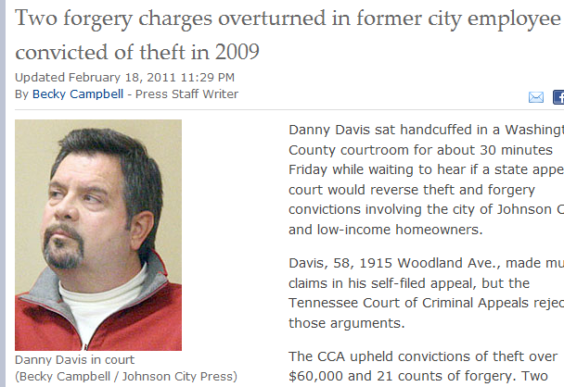
“Newsworthy” Story #4
Johnson City, TN scandal:
  Danny Davis had worked for Johnson City more than 30 years when the investigation into what prosecutors called a fake company got him fired. That company, Gray Home Improvements, had submitted an unusually high number of winning bids in a federally funded program to assist low-income homeowners make residential repairs. After Gray Home Improvements won the bid, Davis hired other subcontractors at a lower price to do the work and pocketed the difference.
Notes:
Clark said Davis took well more than $100,000 from the program and likely took more because investigators couldn’t go through all the records.

Slide 23
Story #4 – What We Learned
Review internal controls over procurement process
  Is there adequate segregation of duties over the evaluation and approval process
  Is there a written set of policies and procedures surrounding the procurement process? Is it monitored to ensure policies are followed?
  Are thresholds for approval process appropriately set?

Slide 24
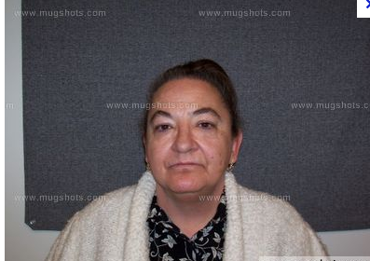
“Newsworthy” Story #5
City of Superior, WI scandal:
  Ruth Ann Olson, former city finance employee, pleaded no contest Monday in Douglas County Circuit Court to one felony count of misconduct in office and one count of misdemeanor theft
  Olson worked as a staff assistant with the city of Superior finance department, stealing money from the landfill and from citizens who came to pay bills for such as storm water fees.
Notes:
When she called in sick on Nov. 15, a staff member covering her position found unsecured deposit packets from the landfill in Olson’s desk with cash and checks in them. One had the correct amount in it — $148. The other was supposed to have $865 in it, but only had $665. Olson made the $865 deposit the following day, but did not deposit the $148. When questioned by Finance Director Jean Vito, Olson said she took the $200 and replaced it with other city funds — the $148 landfill deposit and $52 from a library deposit — to make the deposit whole.
“I haven’t been doing it for very long, just a little bit here and there,” she told Vito. “I had to have it. I had no other place to get it.”
Olson told Detective Mike Jaszczak of the Superior Police Department that she used the $201 to pay a fuel oil bill and she intended to give the money back. She also admitted to taking $671.22 of city cash in October to cover her utility bill and house payment. In addition, the Superior woman gave herself two dog licenses without paying for them, the complaint stated.

Slide 25
“Newsworthy” Story #5
When she called in sick on Nov. 15, a staff member covering her position found unsecured deposit packets from the landfill in Olson’s desk with cash and checks in them. One had the correct amount in it — $148. The other was supposed to have $865 in it, but only had $665. Olson made the $865 deposit the following day, but did not deposit the $148. When questioned by Finance Director Jean Vito, Olson said she took the $200 and replaced it with other city funds — the $148 landfill deposit and $52 from a library deposit — to make the deposit whole.
“I haven’t been doing it for very long, just a little bit here and there,” she told Vito. “I had to have it. I had no other place to get it.”

Slide 26
Story #5 – What We Learned
Just because she looks like the librarian at your old middle school doesn’t mean she’s trustworthy
Have a written cash handling policy and provide training and ensure proper enforcement
Ensure prompt reconciliation and proper deposit of ALL sources of cash receipts
Require periodic vacations for all employees

Slide 27
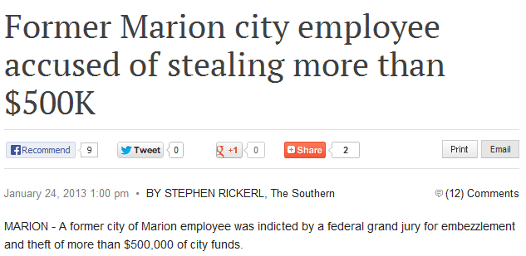
“Newsworthy” Story #6

Slide 28
“Newsworthy” Story #6
According to the indictment, Marion Police were advised on April 20 that Heyde was handling city water deposit funds suspiciously. The water department’s daily deposits for that week contained only checks, but no cash. Cash deposits were made later in the week
According to the indictment, Marion Police were advised on April 20 that Heyde was handling city water deposit funds suspiciously. The water department’s daily deposits for that week contained only checks, but no cash. Cash deposits were made later in the week

Slide 29
“Newsworthy” Story #6
A three-year audit of the department was completed in August and found there were falsified adjustments made to customer accounts, falsified payments to accounts, accounts were created for fictitious customers and payments were not recorded as payments, but adjustments to accounts

Slide 30
Story #6 – What We Learned
Written policy and adequate employee training surrounding utility billing adjustments
Periodic review/audit of adjustments
Restricted access to new customer utility setup module; all new entries must be supported by adequate documentation

Slide 31

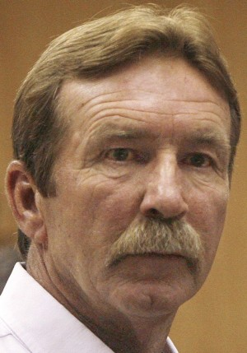
“Newsworthy” Story #7
City of Tuscan, AZ scandal:
  Former city Transportation Department employees Kurt Hough and Bobby Palomarez have been indicted by a Pima County grand jury on multiple felony counts including fraud, theft and criminal enterprise
  Hough and Palomarez were among five transportation supervisors and workers who resigned or were fired on Sept. 6 after an investigation into allegations they misappropriated thousands of dollars' worth of city materials and equipment for use on private construction jobs, many of which were performed by city workers on city time.
Notes:
In 1991, Hough pleaded guilty to theft by conversion and was sentenced to a year and a half in an Arizona prison. He also was ordered to pay $11,125 in restitution as part of a plea agreement.
He also was convicted of theft by misrepresentation in 1986 and of assault in 1980. He received probation in both cases, according to court records.
After he completed his sentence and paid restitution, Hough successfully petitioned to have his 1991 conviction vacated and his civil rights restored in 1996.
Rankin said once Hough had his sentence vacated, he could check the "no" box on the application where it asks if you've ever been convicted of a felony, which made it easier for him to move into a position of high responsibility.
Also, the city doesn't perform background checks on entry-level employees, except for certain positions such as jobs that involve contact with children and a few others, City Attorney Mike Rankin said. "But they might want to consider performing them now," he said.
Hough was hired at an entry-level position and worked his way into administration.
For Hough:
• In August 2010, he ordered the construction for $7,883 of an unauthorized concrete motorcycle pad at the city's west lot near East Ajo Way and South Park Avenue because he and his "motorcycle buddies" didn't like parking on asphalt.
• In February 2009, he ordered Palomarez to deliver 15 tons of city dirt to help a friend, Ken Kelly, owner of Kelly Electric, build a BMX track at another friend's home in Vail at a cost of $600.
• Between October 2006 and July 2007, he ordered at least five city workers, plus equipment and materials, to build a retaining wall and pave the parking lot at Kelly Electric, 1144 W. Miracle Mile.
• In May 2010 and again in September 2011, he had a city crew pave a private road in the Midvale Park area.
The investigation accused Palomarez, who was a street supervisor, of:
• In 2010, directing the delivery of multiple loads of dirt and sand to the Sunnyside High School baseball field, where his brother is a coach, and had city employees work on the field.
• In November and December 2009, clearing dirt for a private contractor. The dirt was stored on a city lot and used later for his private side jobs.

Slide 32
“Newsworthy” Story #7
In August 2010, Hough ordered the construction for $7,883 of an unauthorized concrete motorcycle pad at the city's west lot near East Ajo Way and South Park Avenue because he and his "motorcycle buddies" didn't like parking on asphalt.
In February 2009, Hough ordered Palomarez to deliver 15 tons of city dirt to help a friend, Ken Kelly, owner of Kelly Electric, build a BMX track at another friend's home in Vail at a cost of $600.
Between October 2006 and July 2007, Hough ordered at least five city workers, plus equipment and materials, to build a retaining wall and pave the parking lot at Kelly Electric, 1144 W. Miracle Mile.

Slide 33
Story #7 – What We Learned
Segregation of duties required; involve more individuals in the review and approval process relating to repair, maintenance, and improvement projects
Identification of potential related parties or conflicts of interest

Slide 34
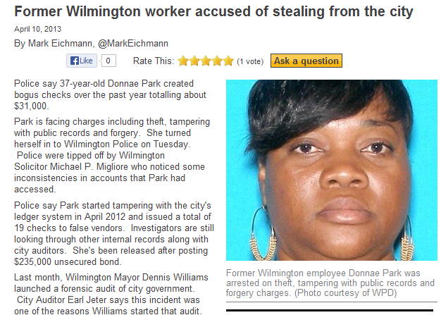
“Newsworthy” Story #8

Slide 35
“Newsworthy” Story #8
Police say 37-year-old Donnae Park created bogus checks over the past year totalling about $31,000
Police say Park started tampering with the city's ledger system in April 2012 and issued a total of 19 checks to false vendors. Investigators are still looking through other internal records along with city auditors. She's been released after posting $235,000 unsecured bond

Slide 36
Story #8 – What We Learned
Evaluate invoice review and payment approval process
Restricted system access to add/modify vendors
Anonymous tip hotline
Financial analytical review analysis (periodic budget to actual and prior period to current period comparisons)
Notes:
Automate the check-writing system

Slide 37
Questions and Comments
Andrew Laflin, CPA
Manager
CliftonLarsonAllen LLP
(813) 384-2711 (office)
(813) 784-3140 (cell)
andrew.laflin@claconnect.com

